Slide 1
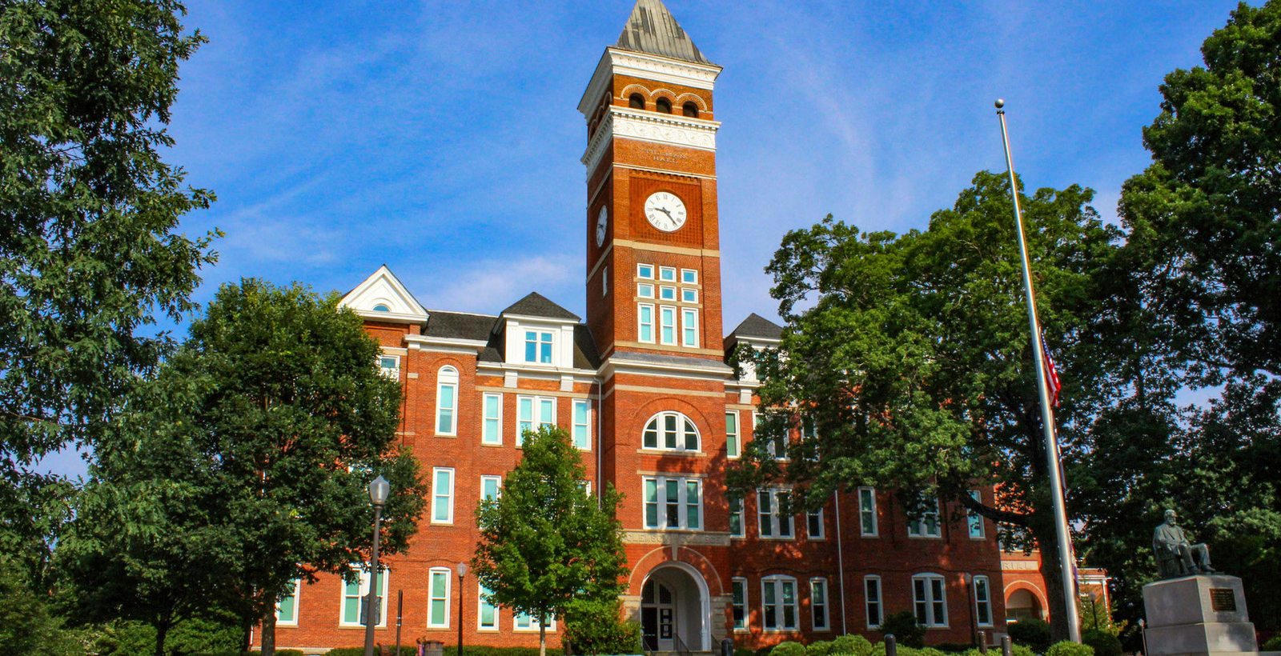

Protein Structure Clustering
Zhiyuan Song
CPSC-8420 Advanced Machine Learning
Astronomy & Physics Department
Clemson University

Slide 2
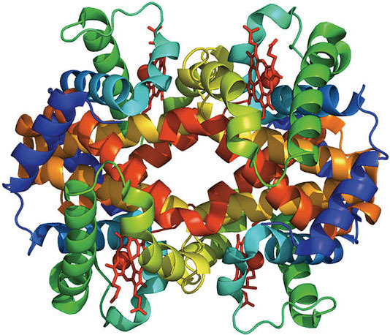

Protein structure
3-D arrangement of atoms in an amino acid-chain molecule
Different structures are responsible for biochemical functions
Some proteins have no intrinsic structures and able to change
Structural clustering and population
https://www.ias.edu/ideas/2014/colwell-proteins

Slide 3
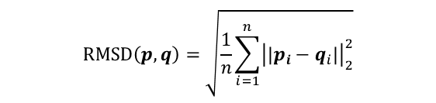
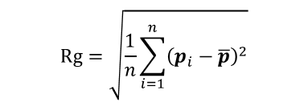
Data Collection
Computational simulation of proteins
calculate atomic coordinates
Overall quantities of a protein (5 features)
Root mean square deviation (RMSD) of atomic positions
A measure of similarity between two protein structures
Radius of gyration (Rg)
Describe the dimensions of a polymer chain
Secondary structures (helices, β sheets)
Potential energy
$$RMSD\left(p,q\right)=\sqrt{\frac{1}{n}\sum_{i=1}^{n}{{\left|\left|p_{i}−q_{i}\right|\right|}_{2}^{2}}}$$
$$Rg=\sqrt{\frac{1}{n}\sum_{i=1}^{n}{{\left(p_{i}−\overline{p}\right)}^{2}}}$$

Slide 4
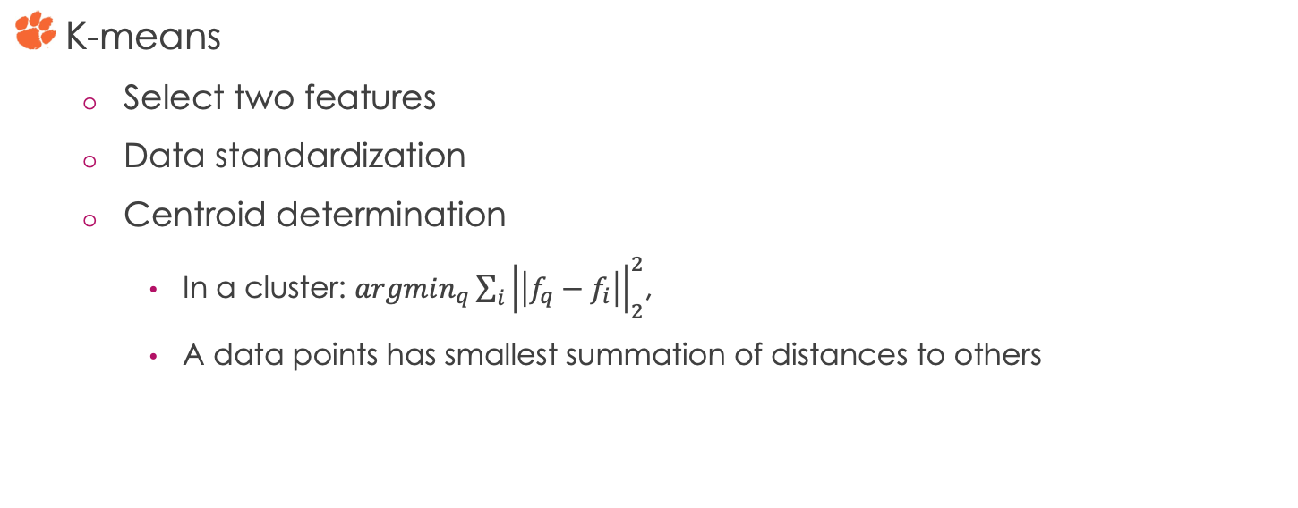
Clustering Methods
K-means
Select two features
Data standardization
Centroid determination
In a cluster: $argmin_{q}\sum_{i}{{\left|\left|f_{q}−f_{i}\right|\right|}_{2}^{2}}$,
A data points has smallest summation of distances to others

Slide 5
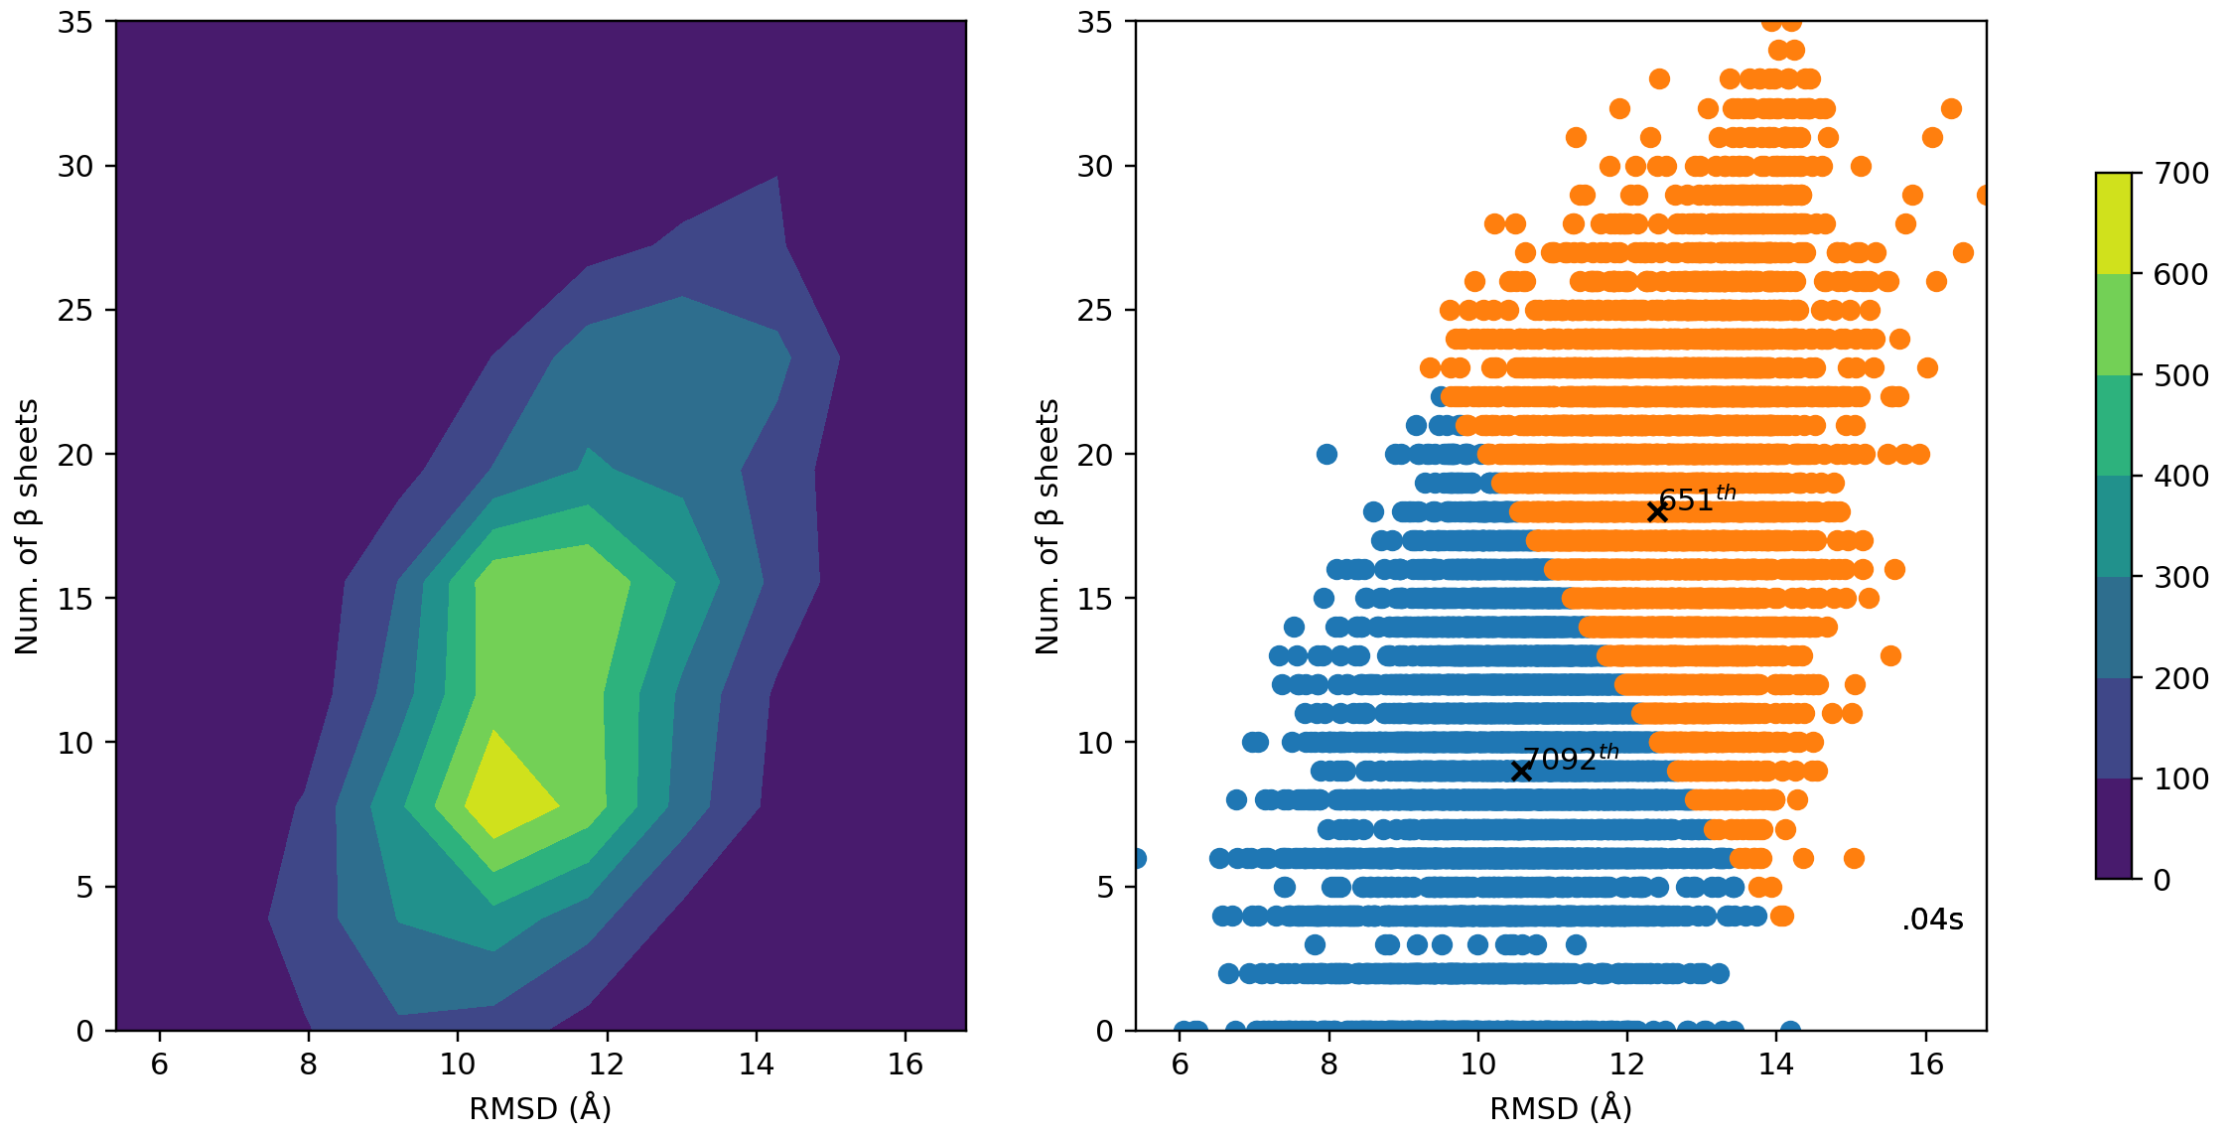
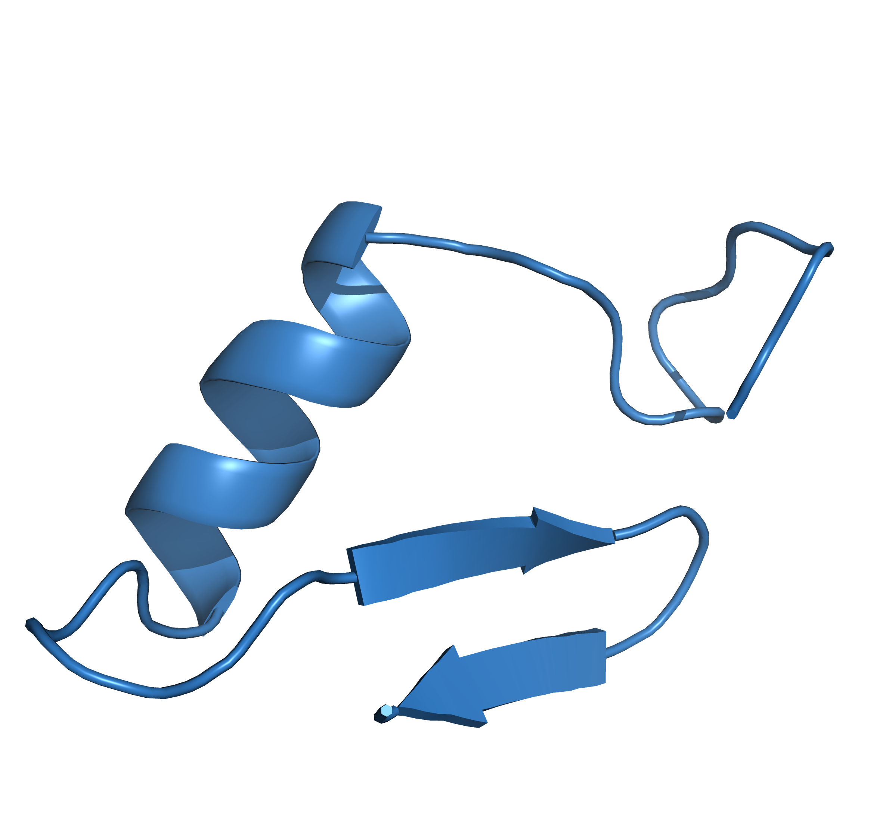
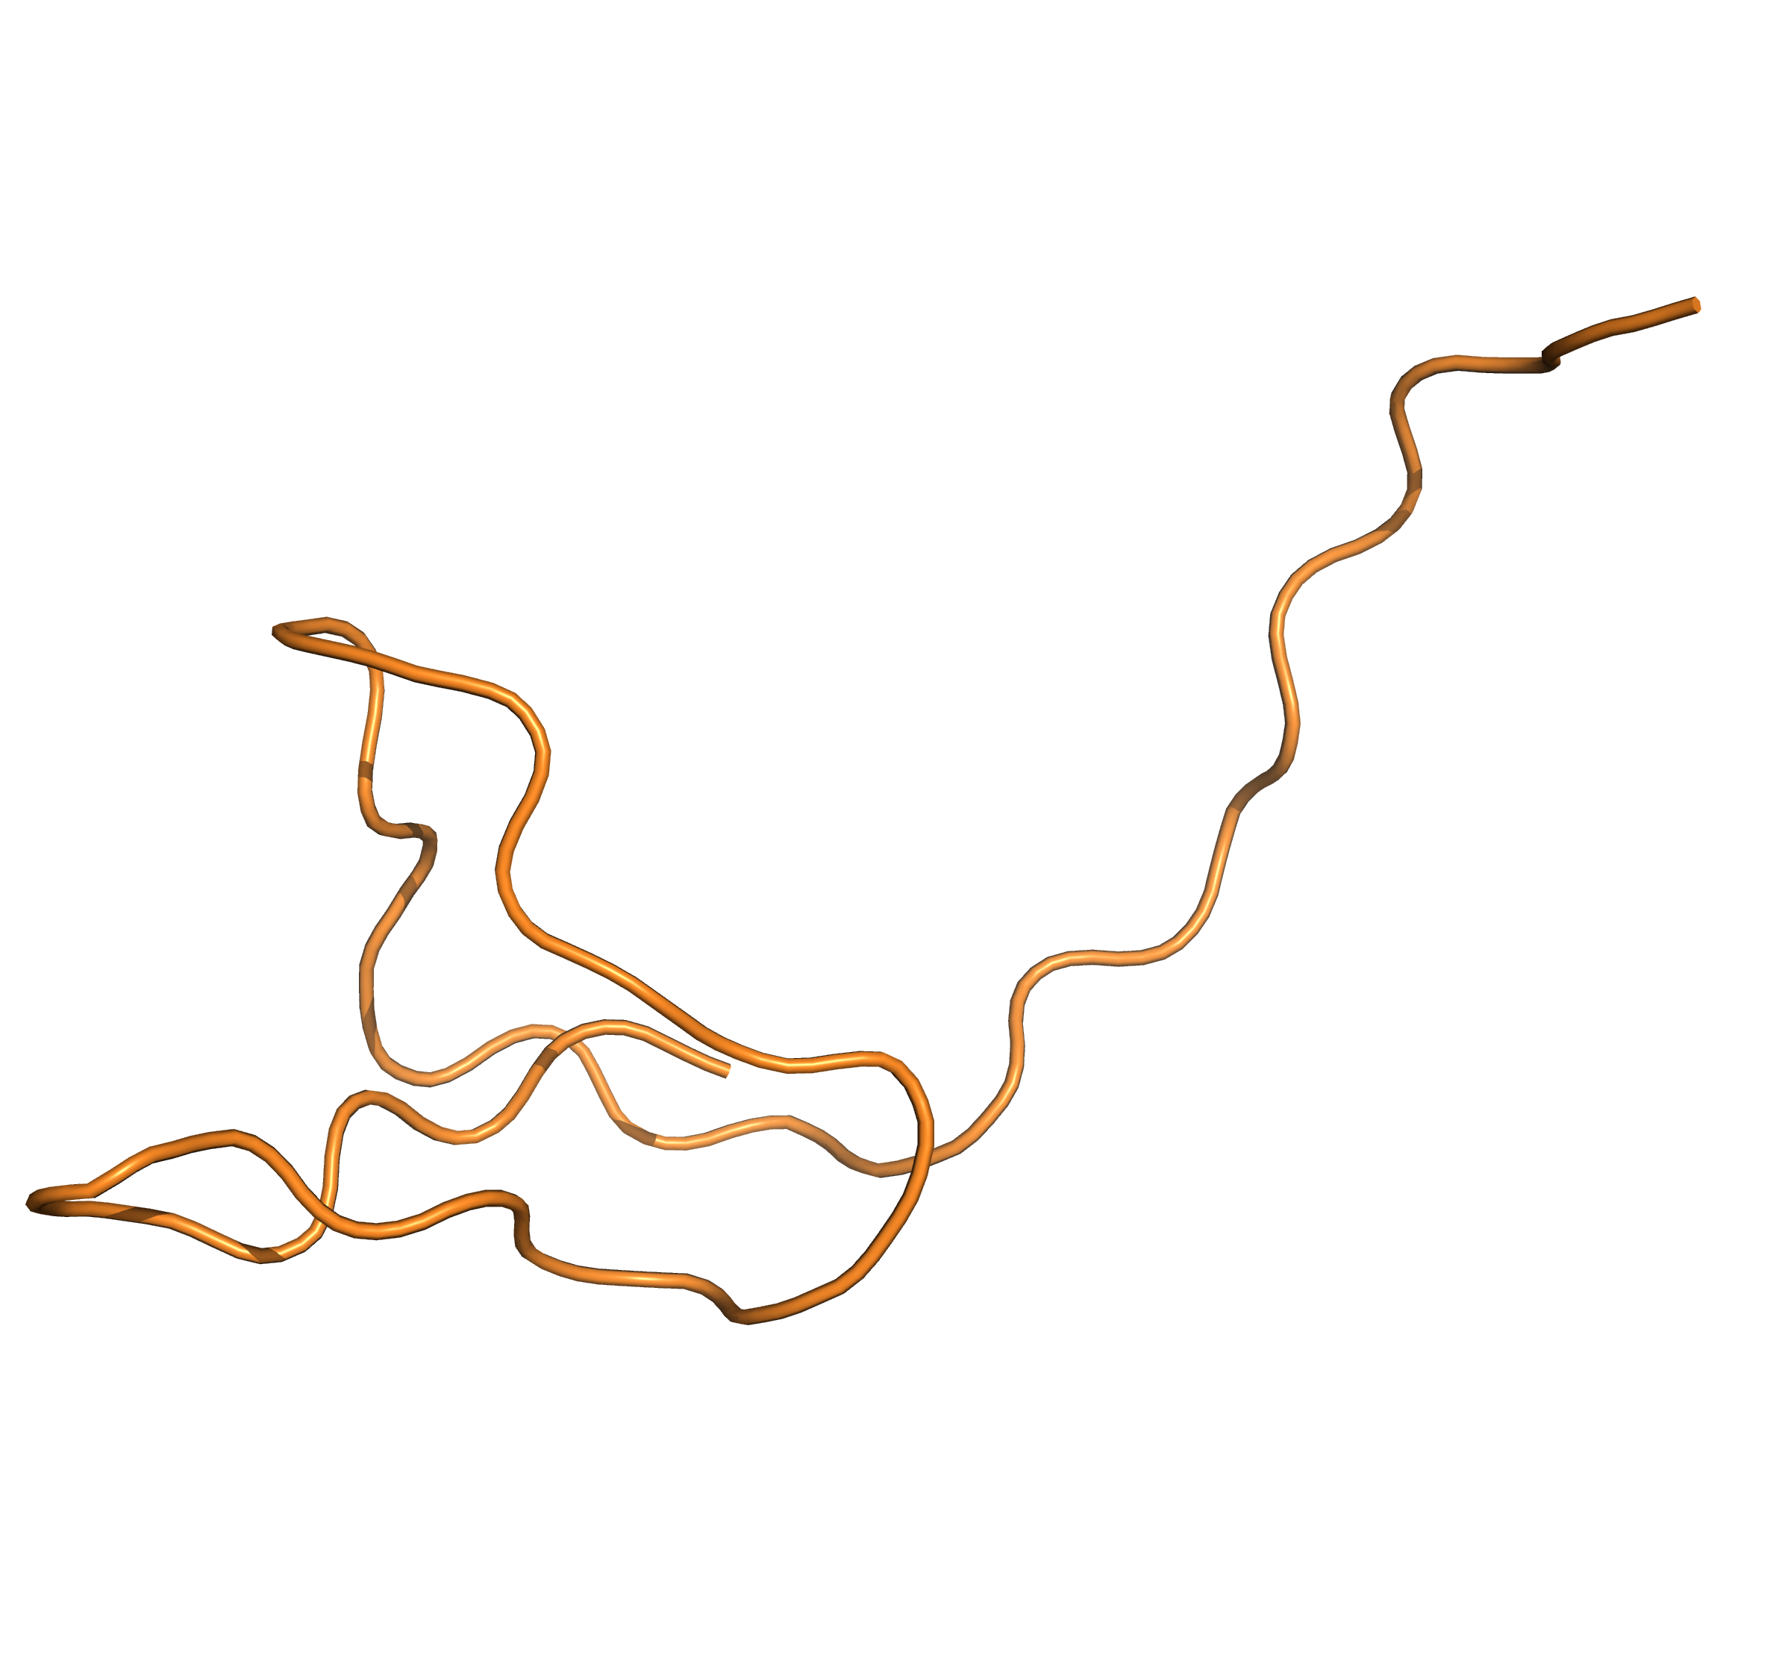
K-means on 2 Selected Features
58.04%
41.96%

Slide 6
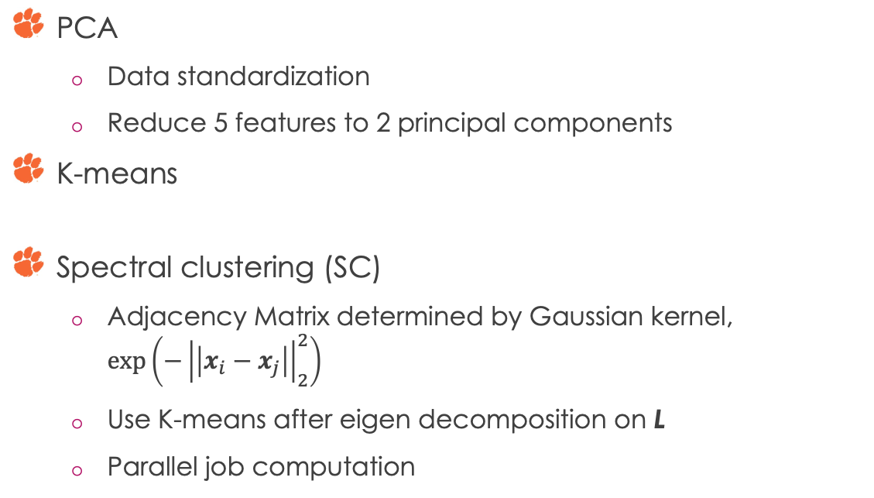
Clustering Methods
PCA
Data standardization
Reduce 5 features to 2 principal components
K-means
Spectral clustering (SC)
Adjacency Matrix determined by Gaussian kernel, $\exp\left(−{\left|\left|x_{i}−x_{j}\right|\right|}_{2}^{2}\right)$
Use K-means after eigen decomposition on L
Parallel job computation

Slide 7
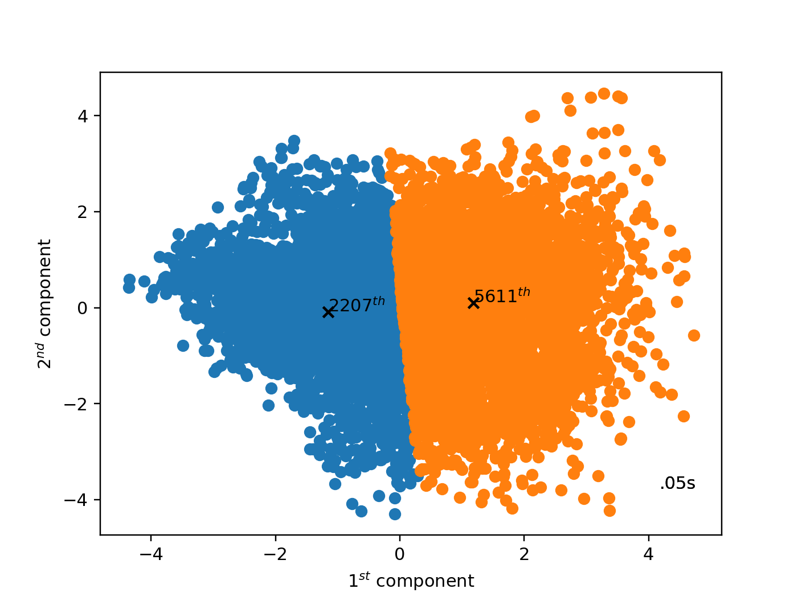
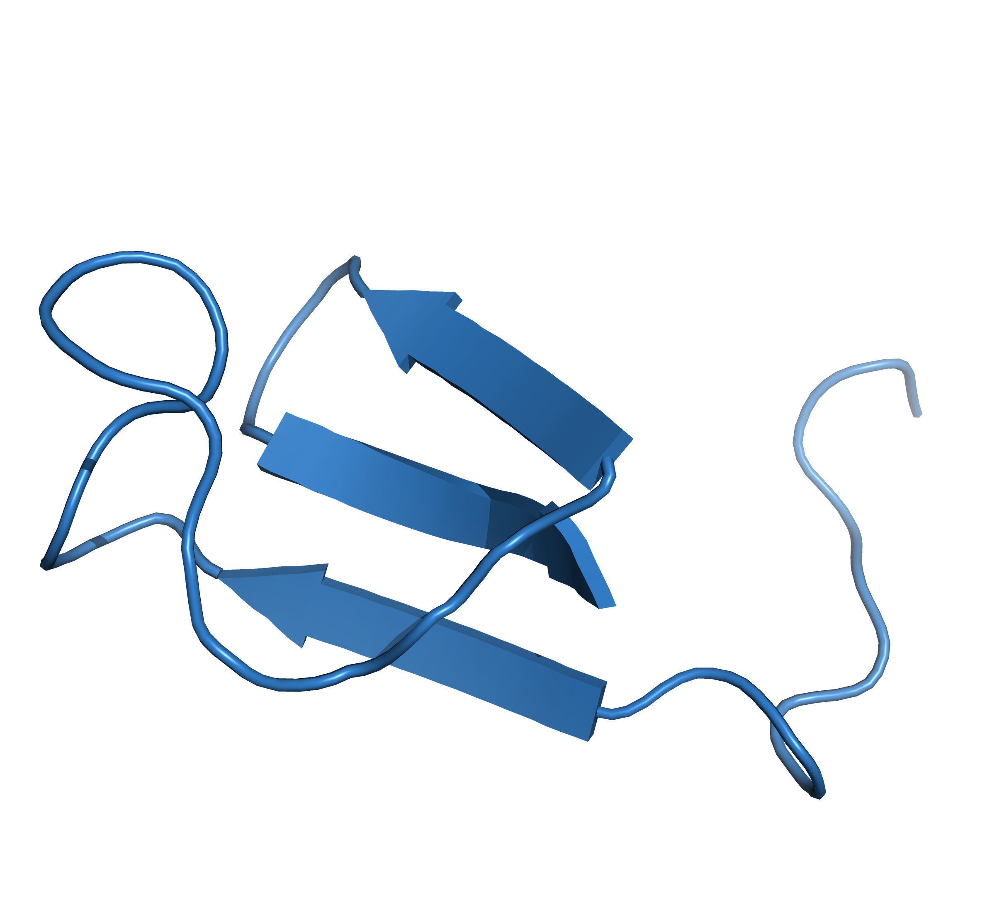
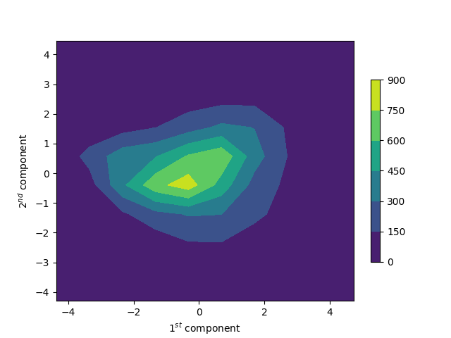
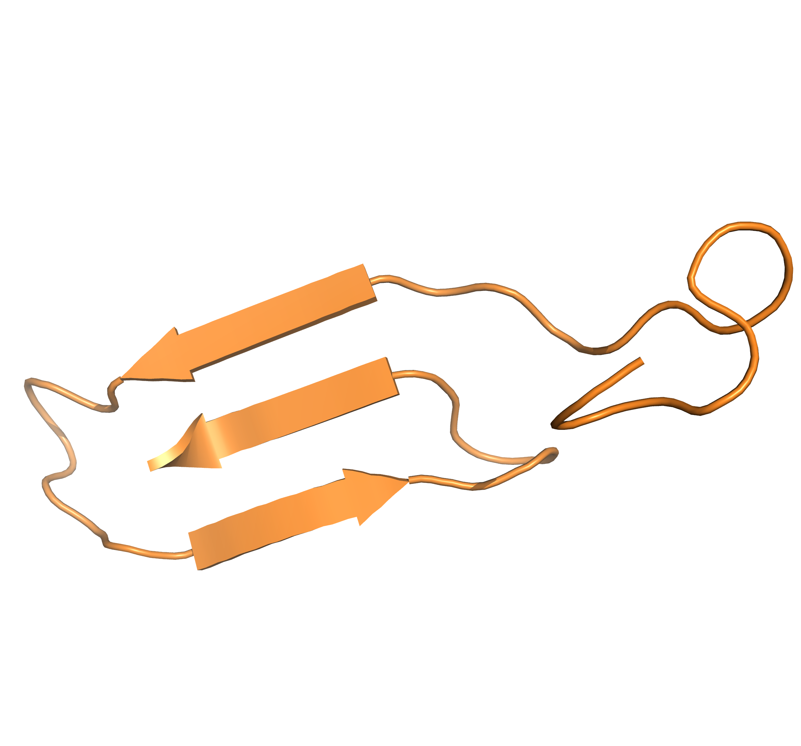
PCA & K-means
48.63%
51.37%

Slide 8
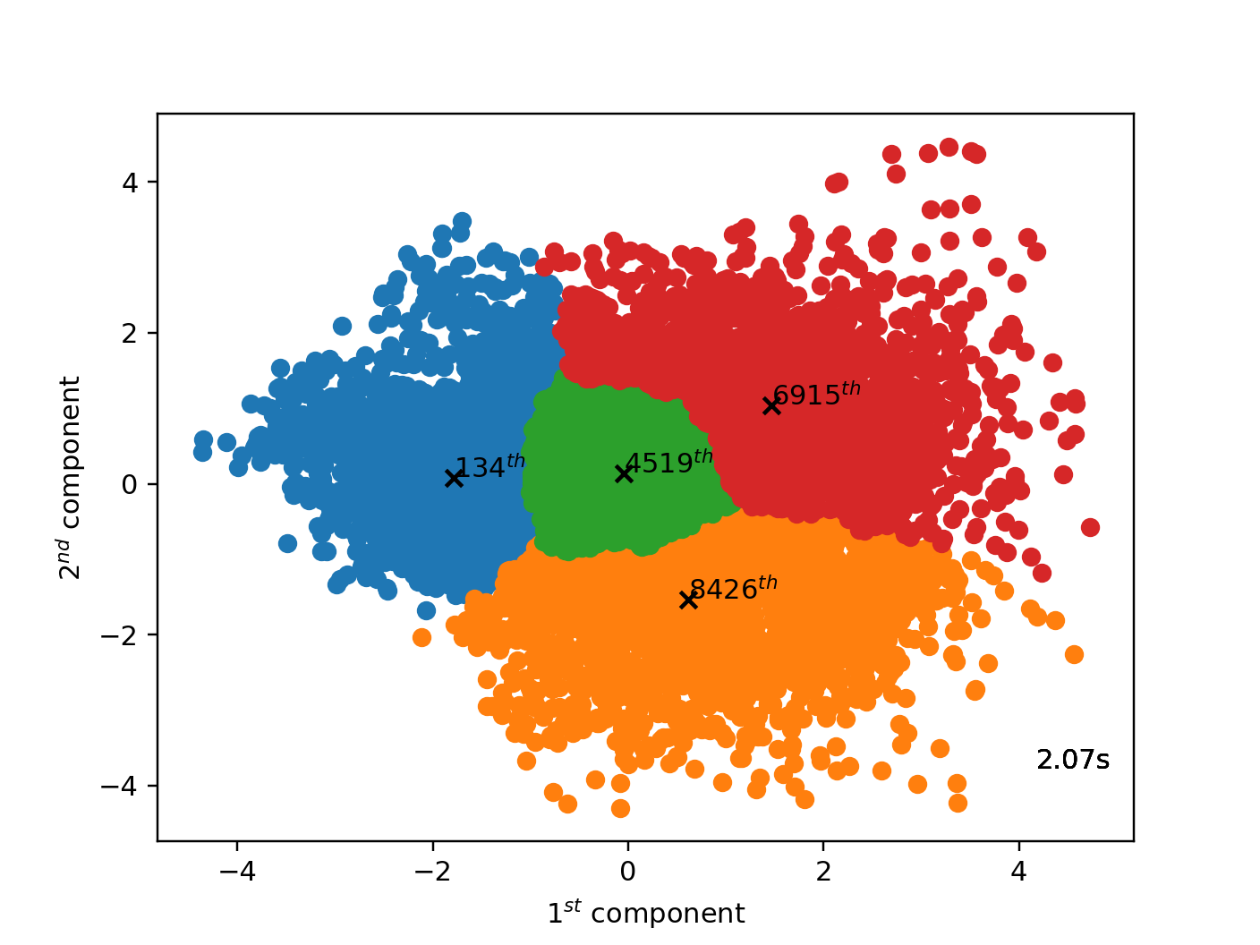
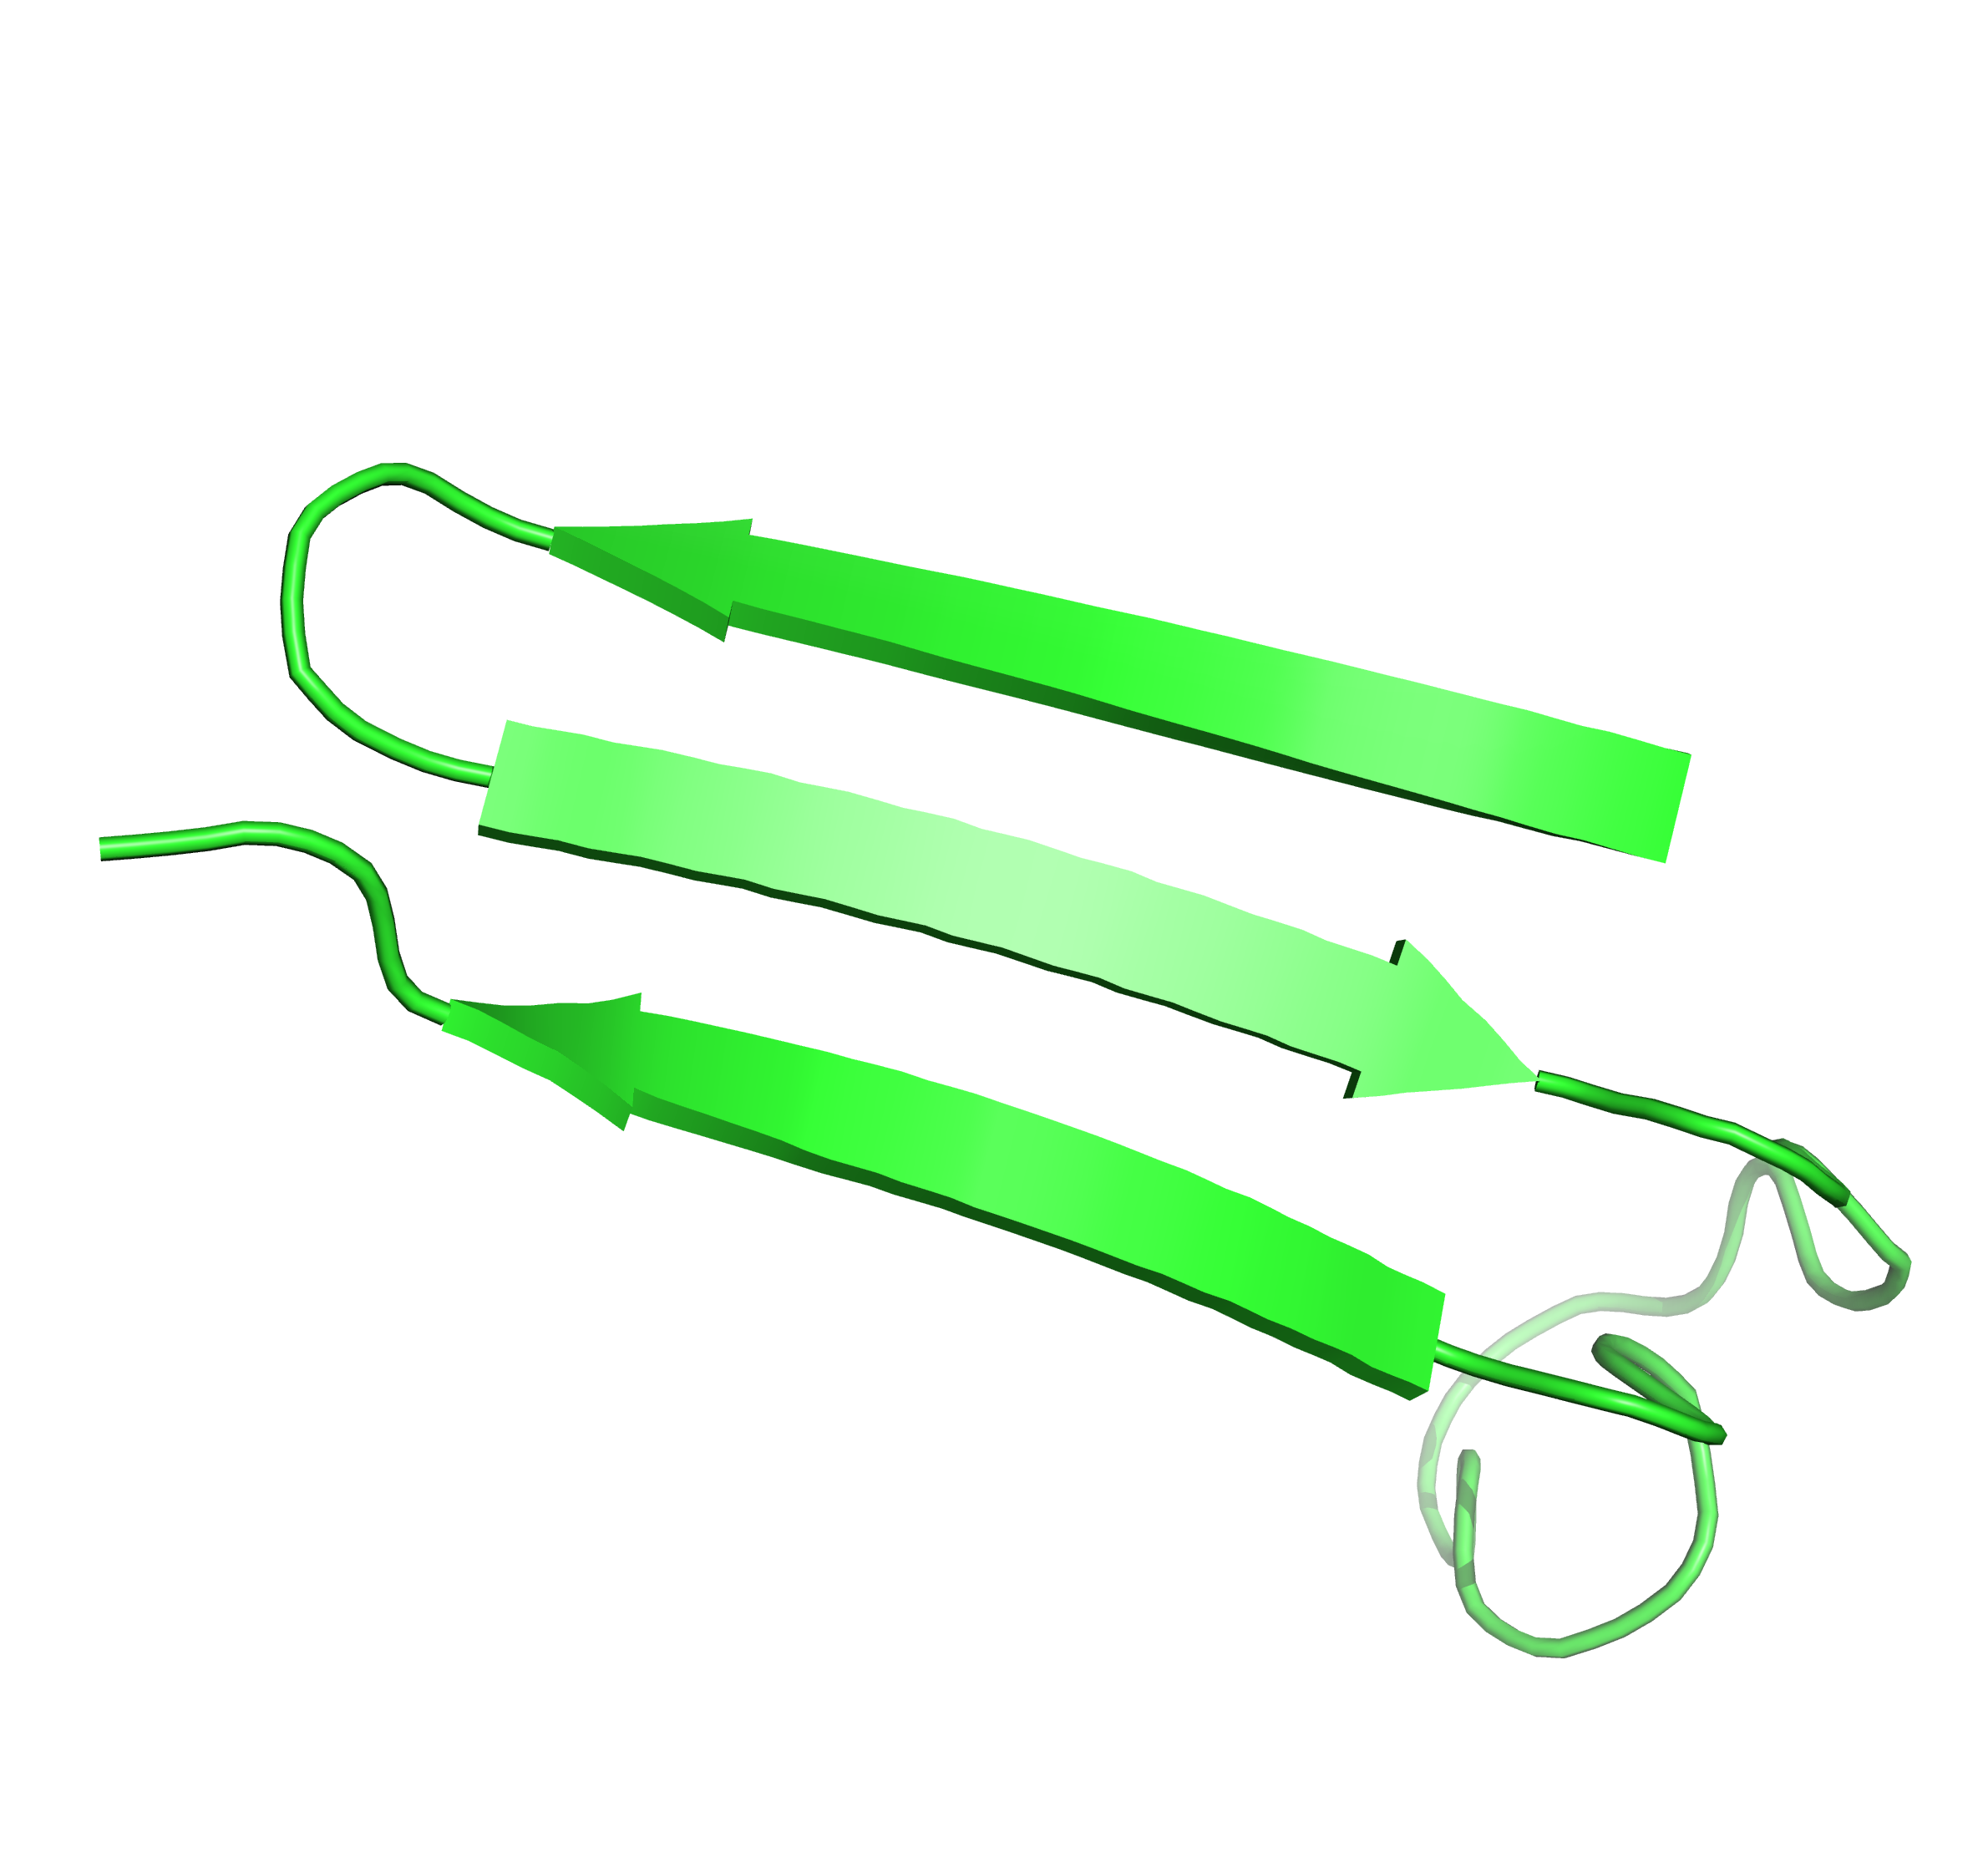
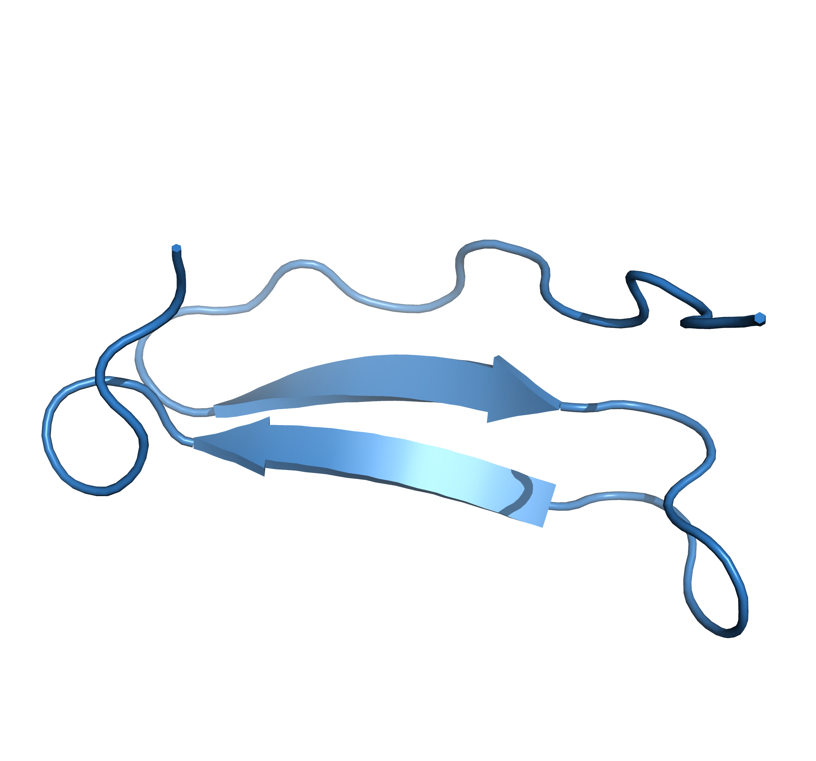
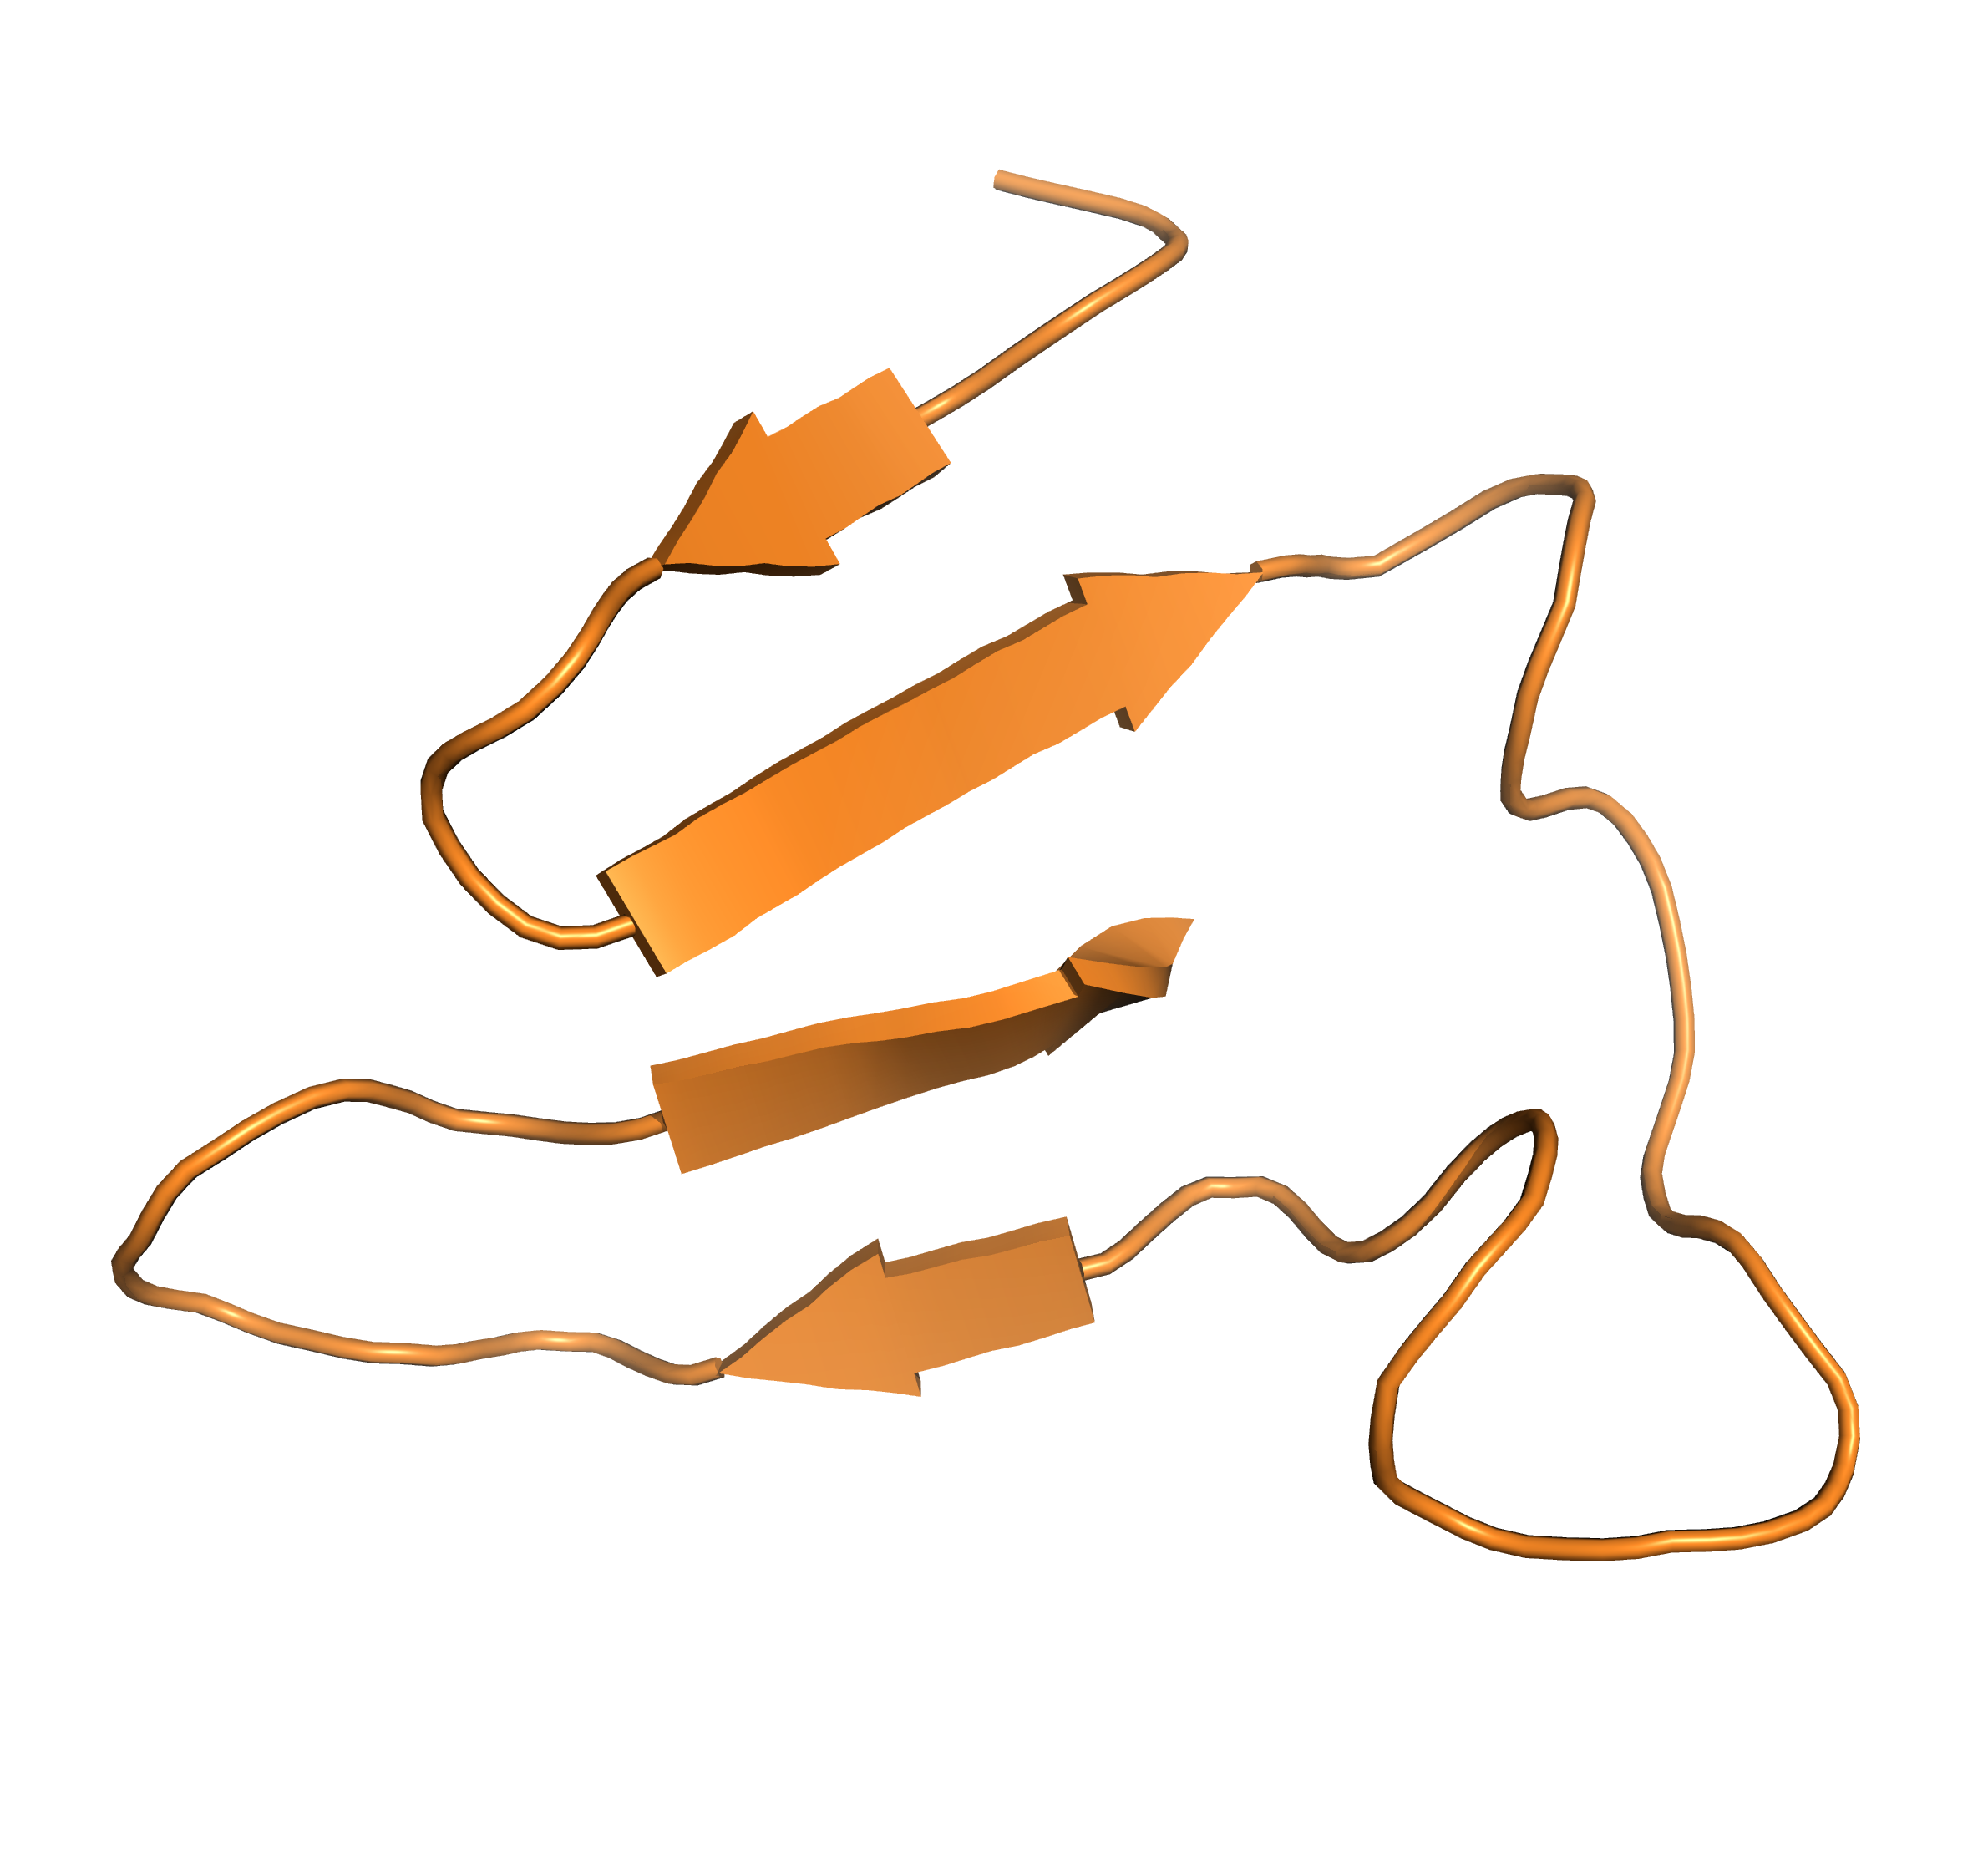
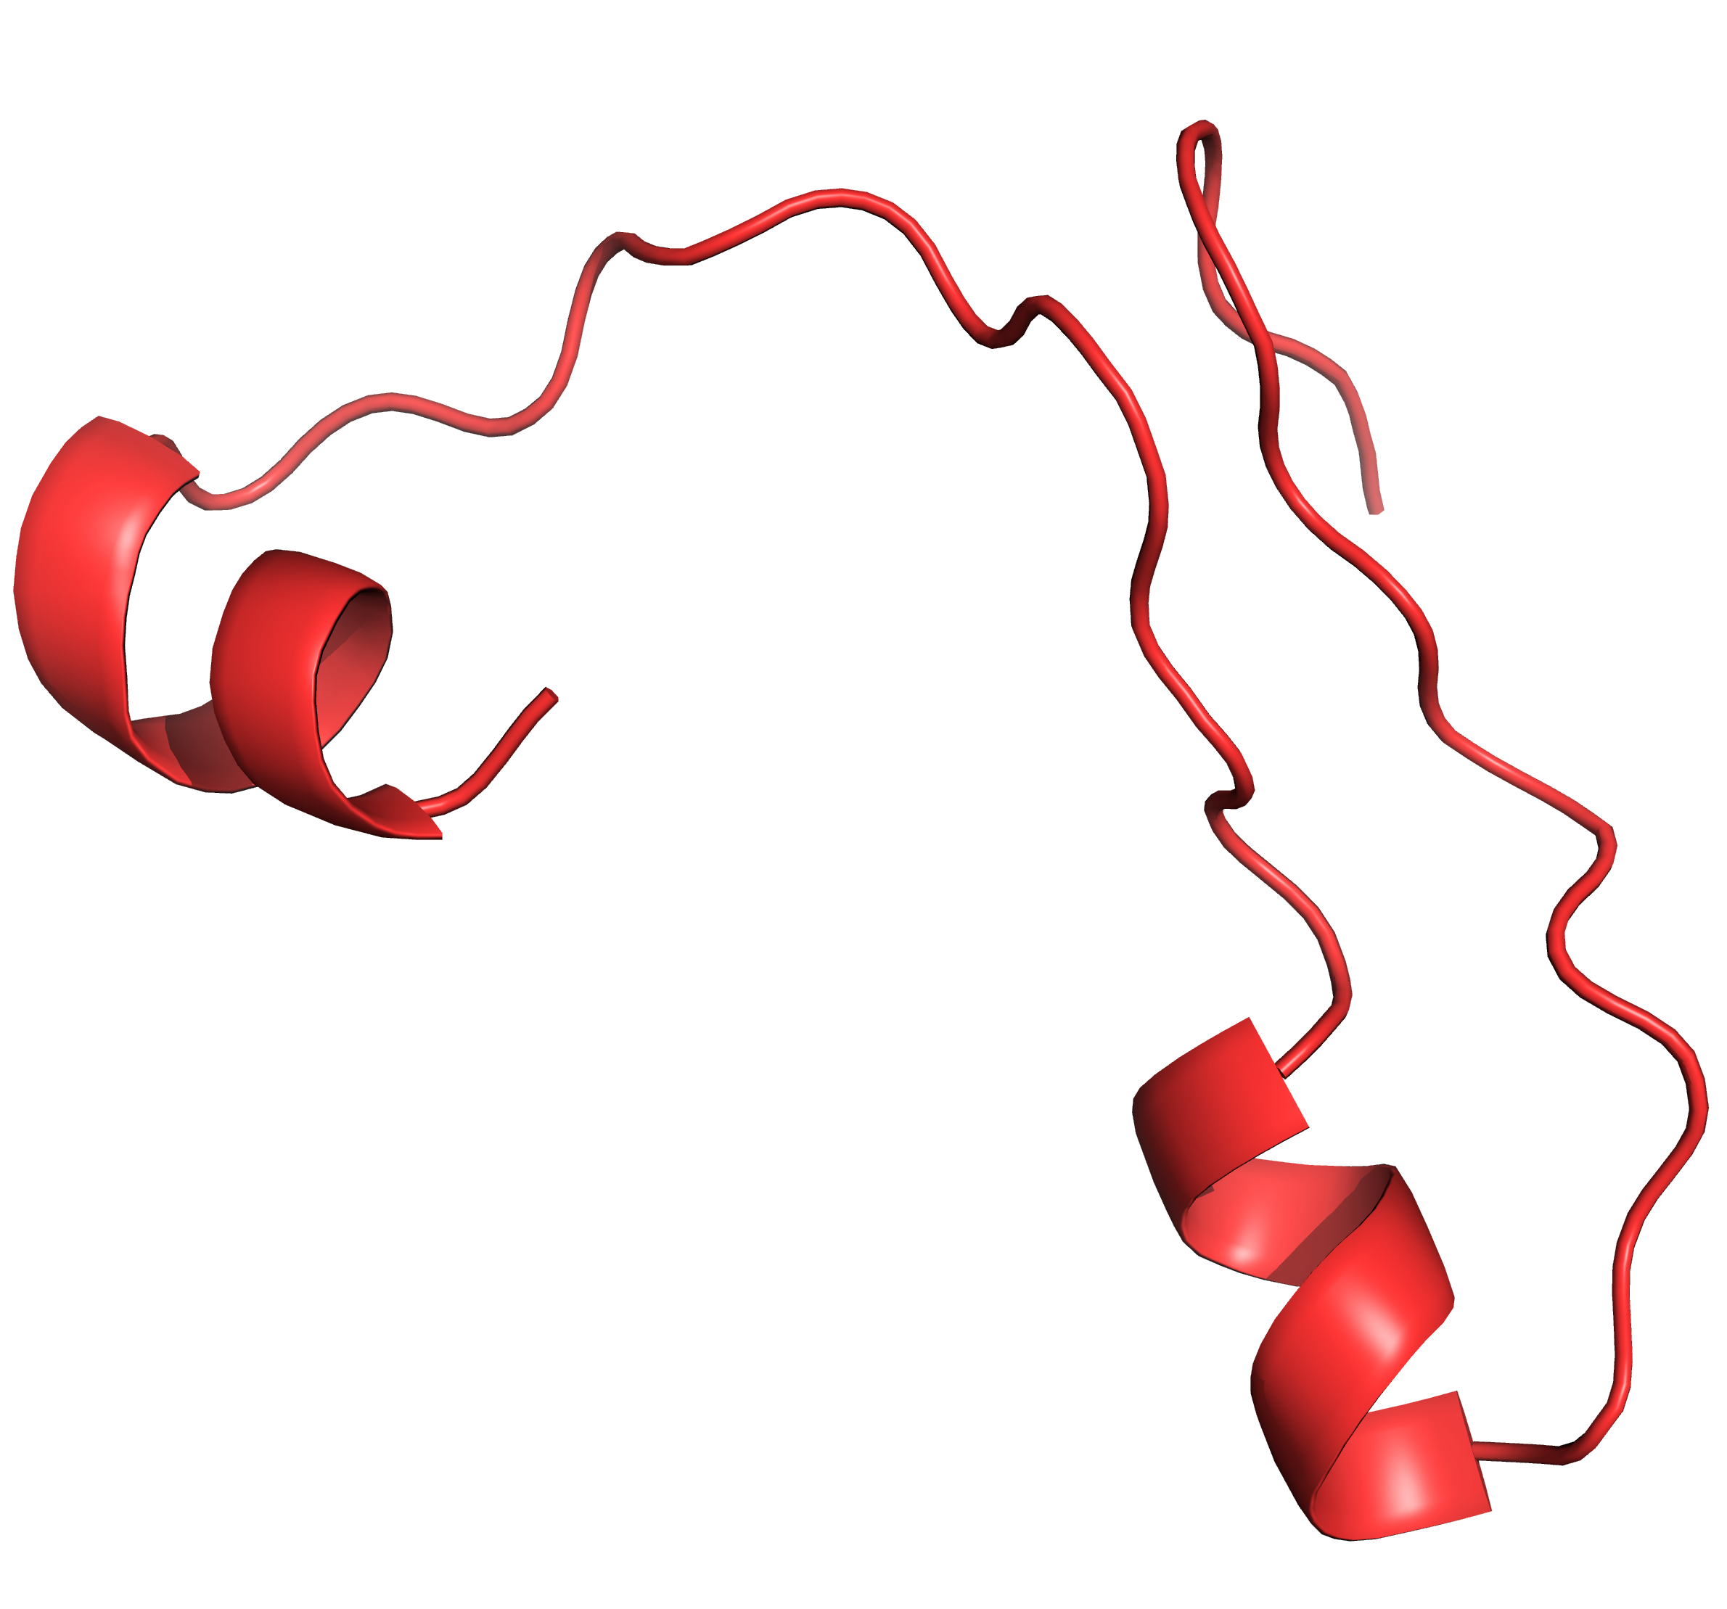
PCA & SC
22.25%
21.43%
29.83%
26.49%

Slide 9
Data Collection
All-atom (N) coordinates
N atoms
3N coordinates for features
Structural alignment with respect to a reference structure
PCA dimension reduction to 2 principal components

Slide 10
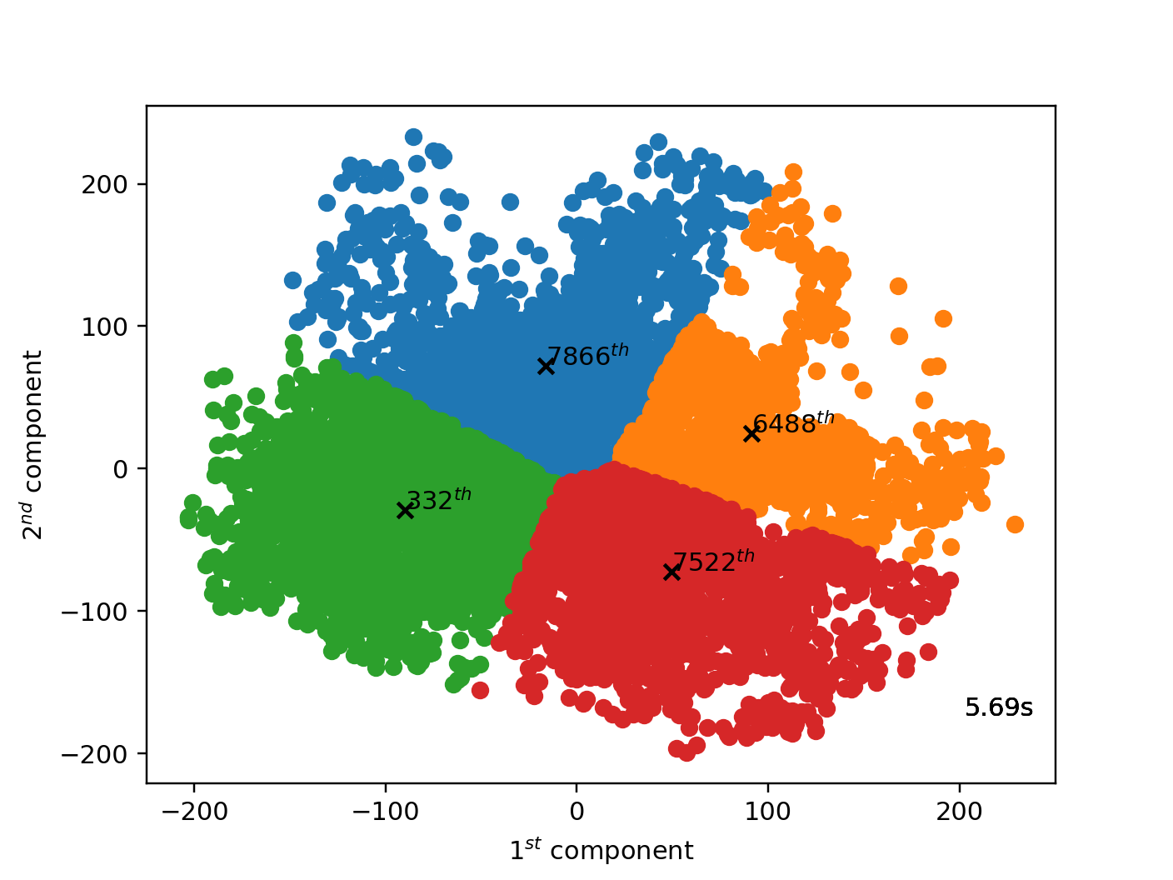
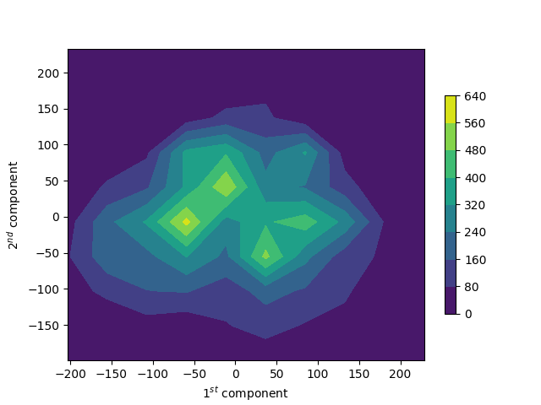
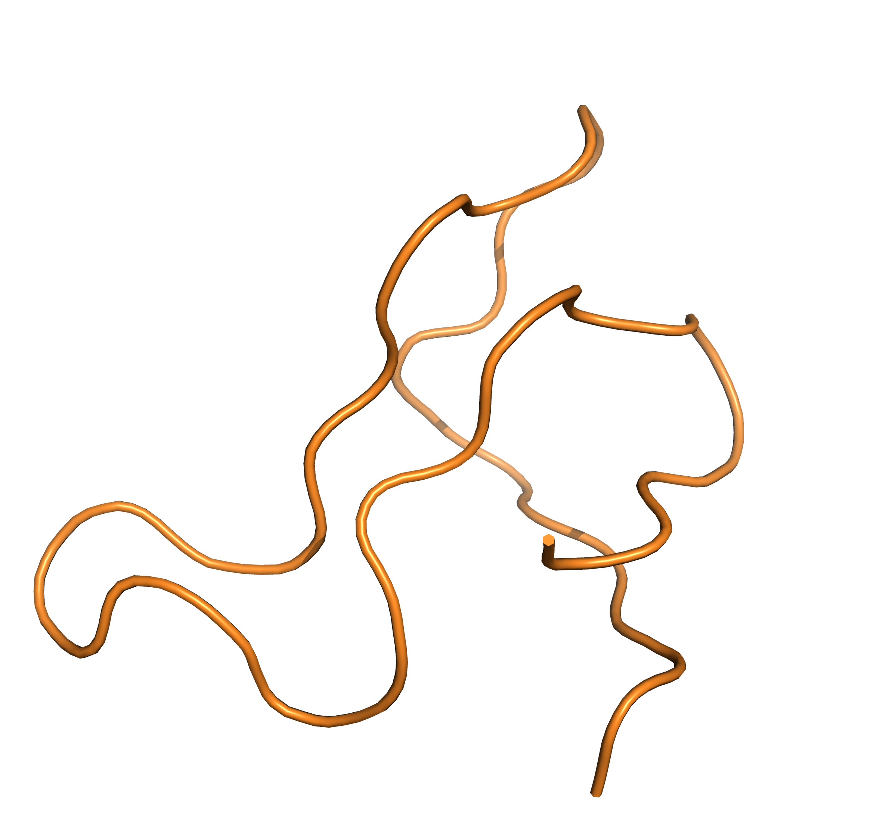
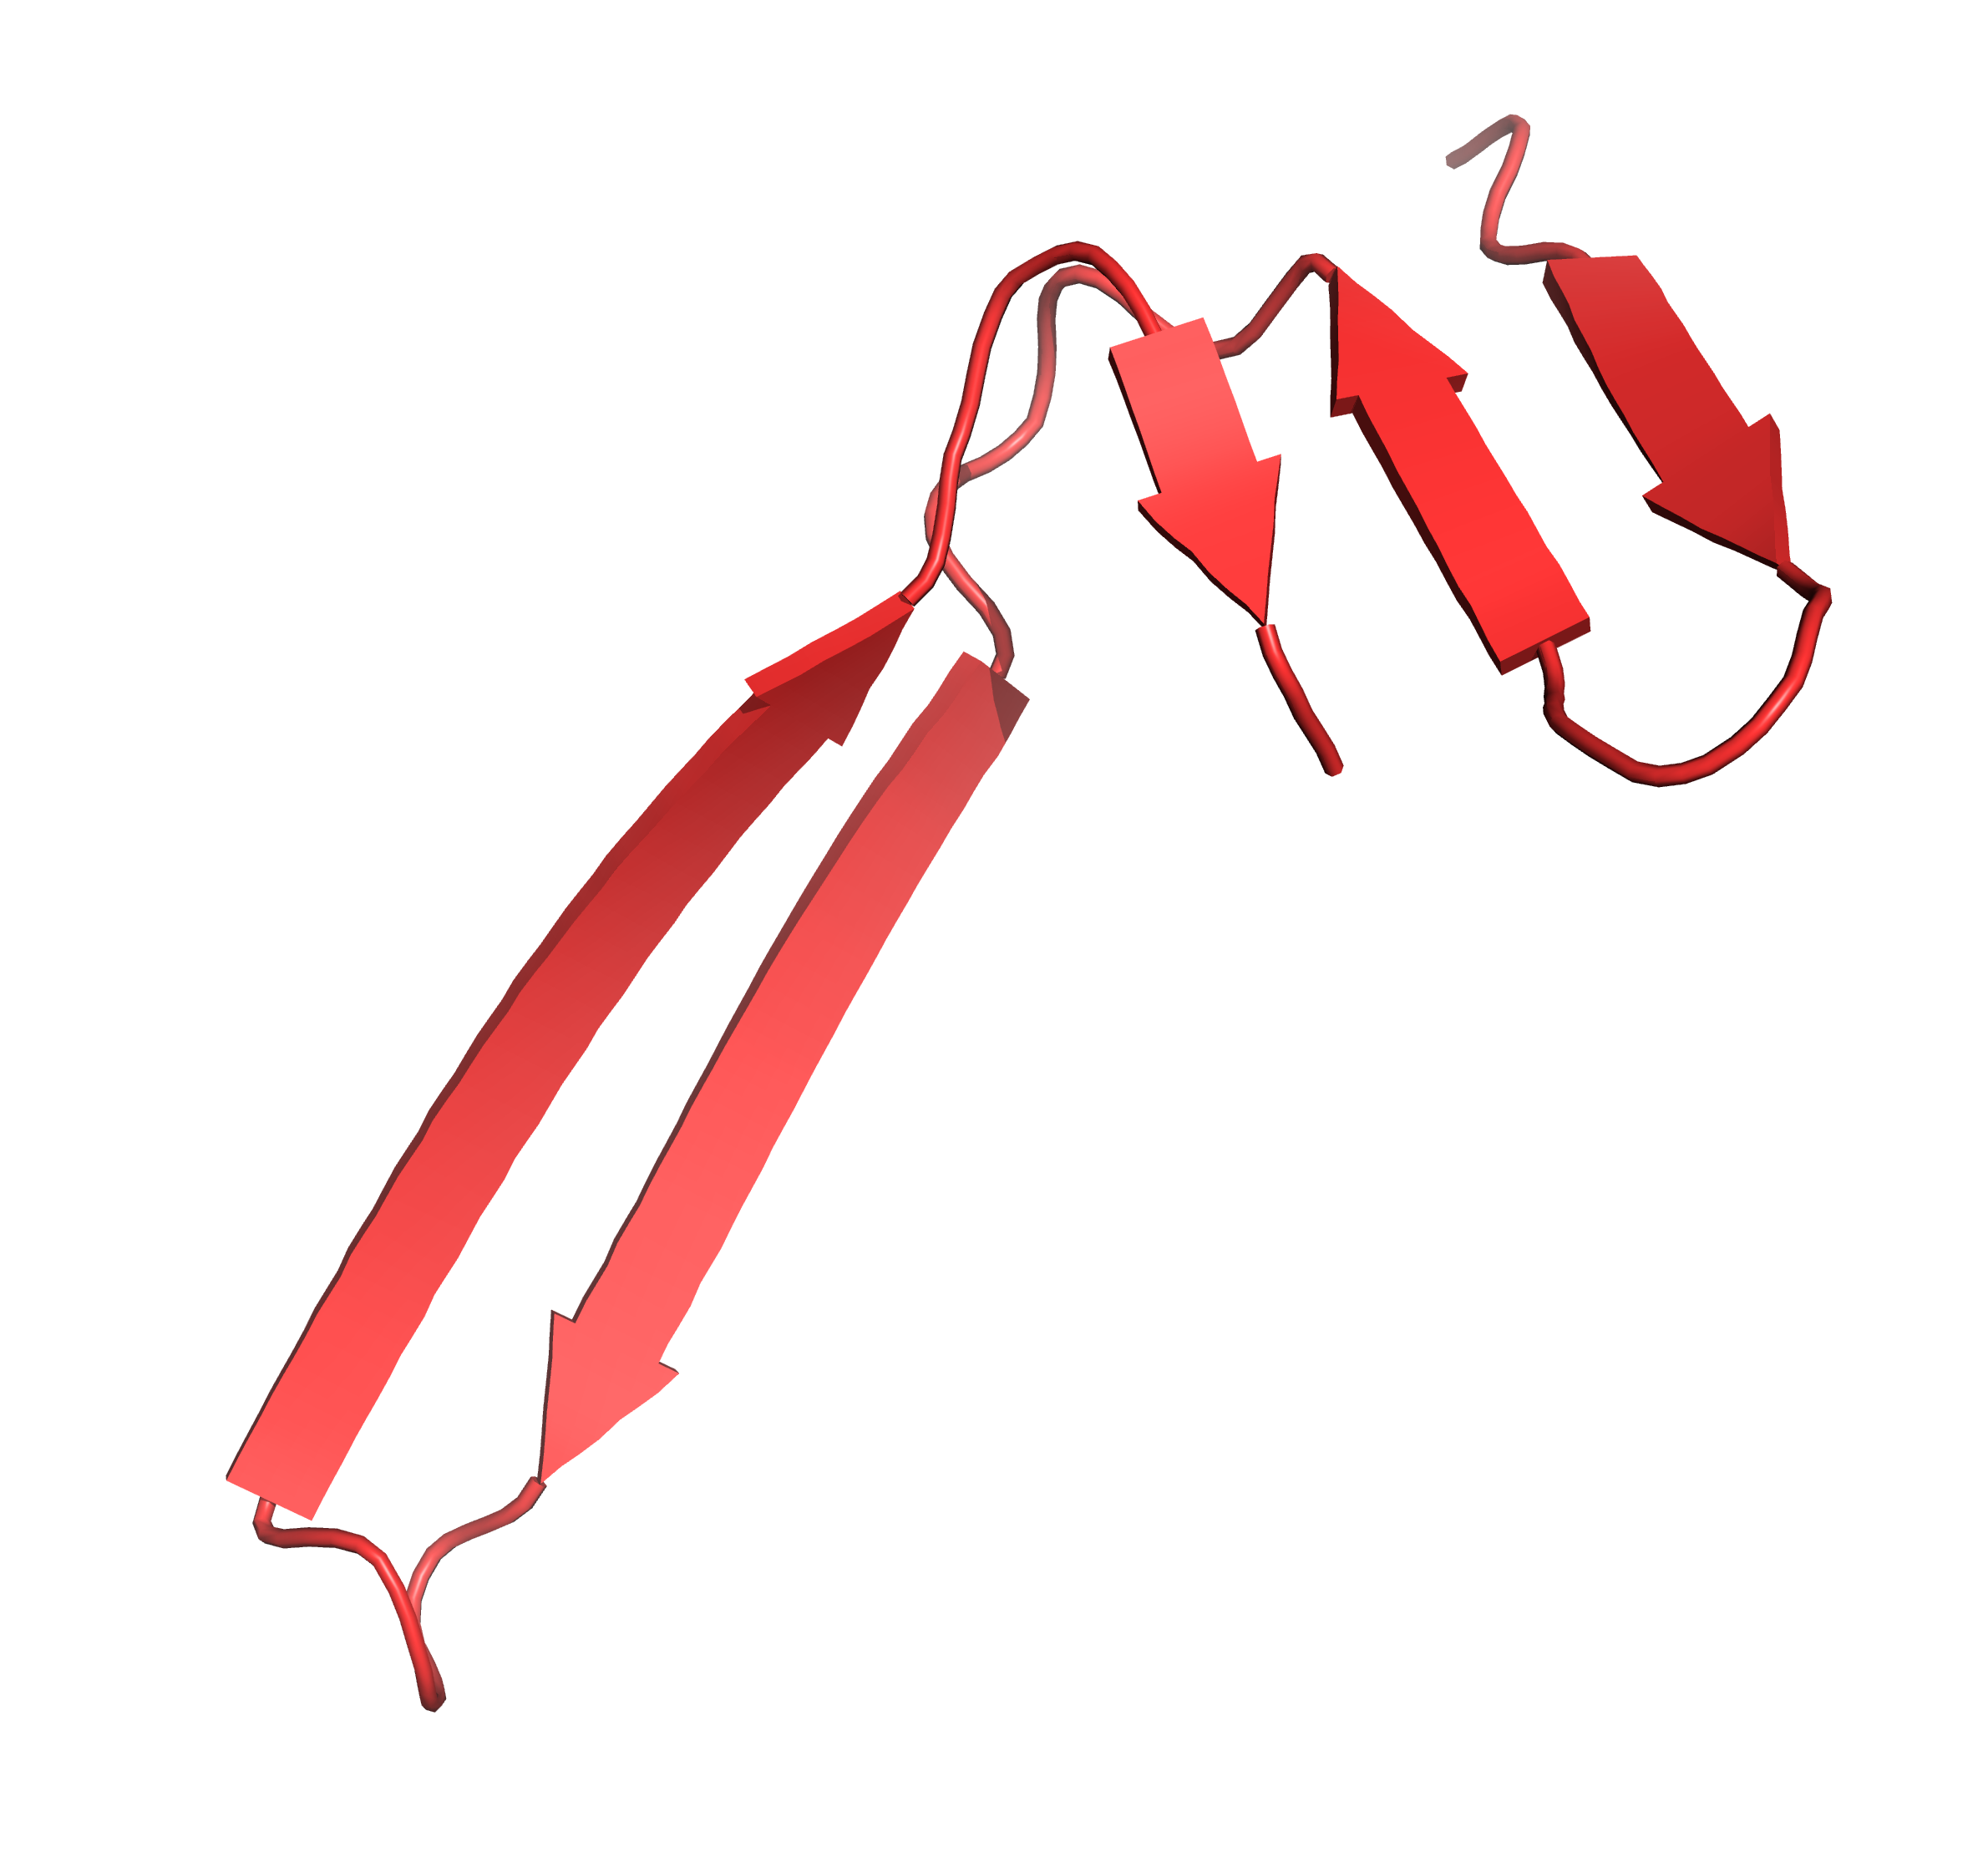
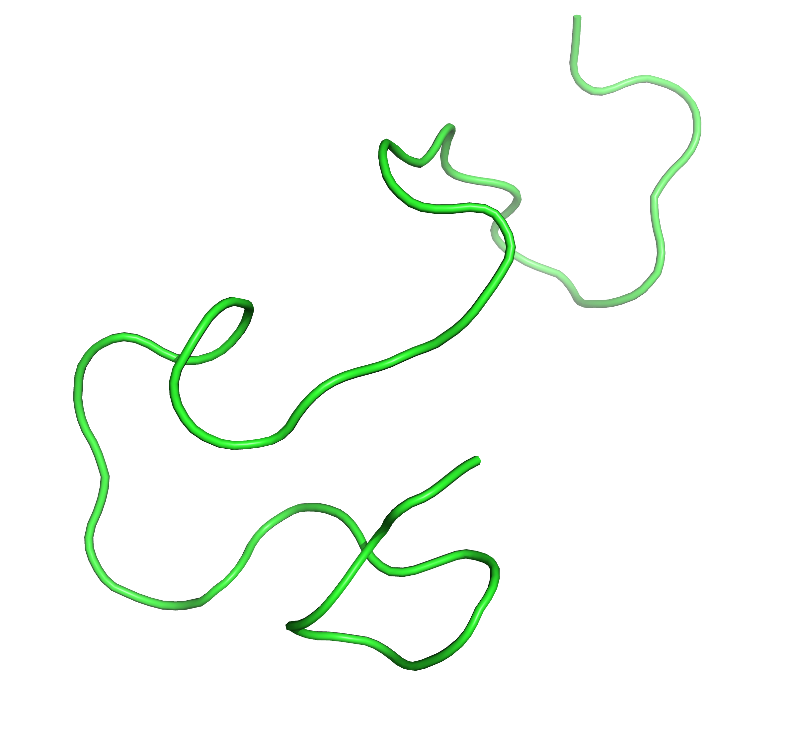
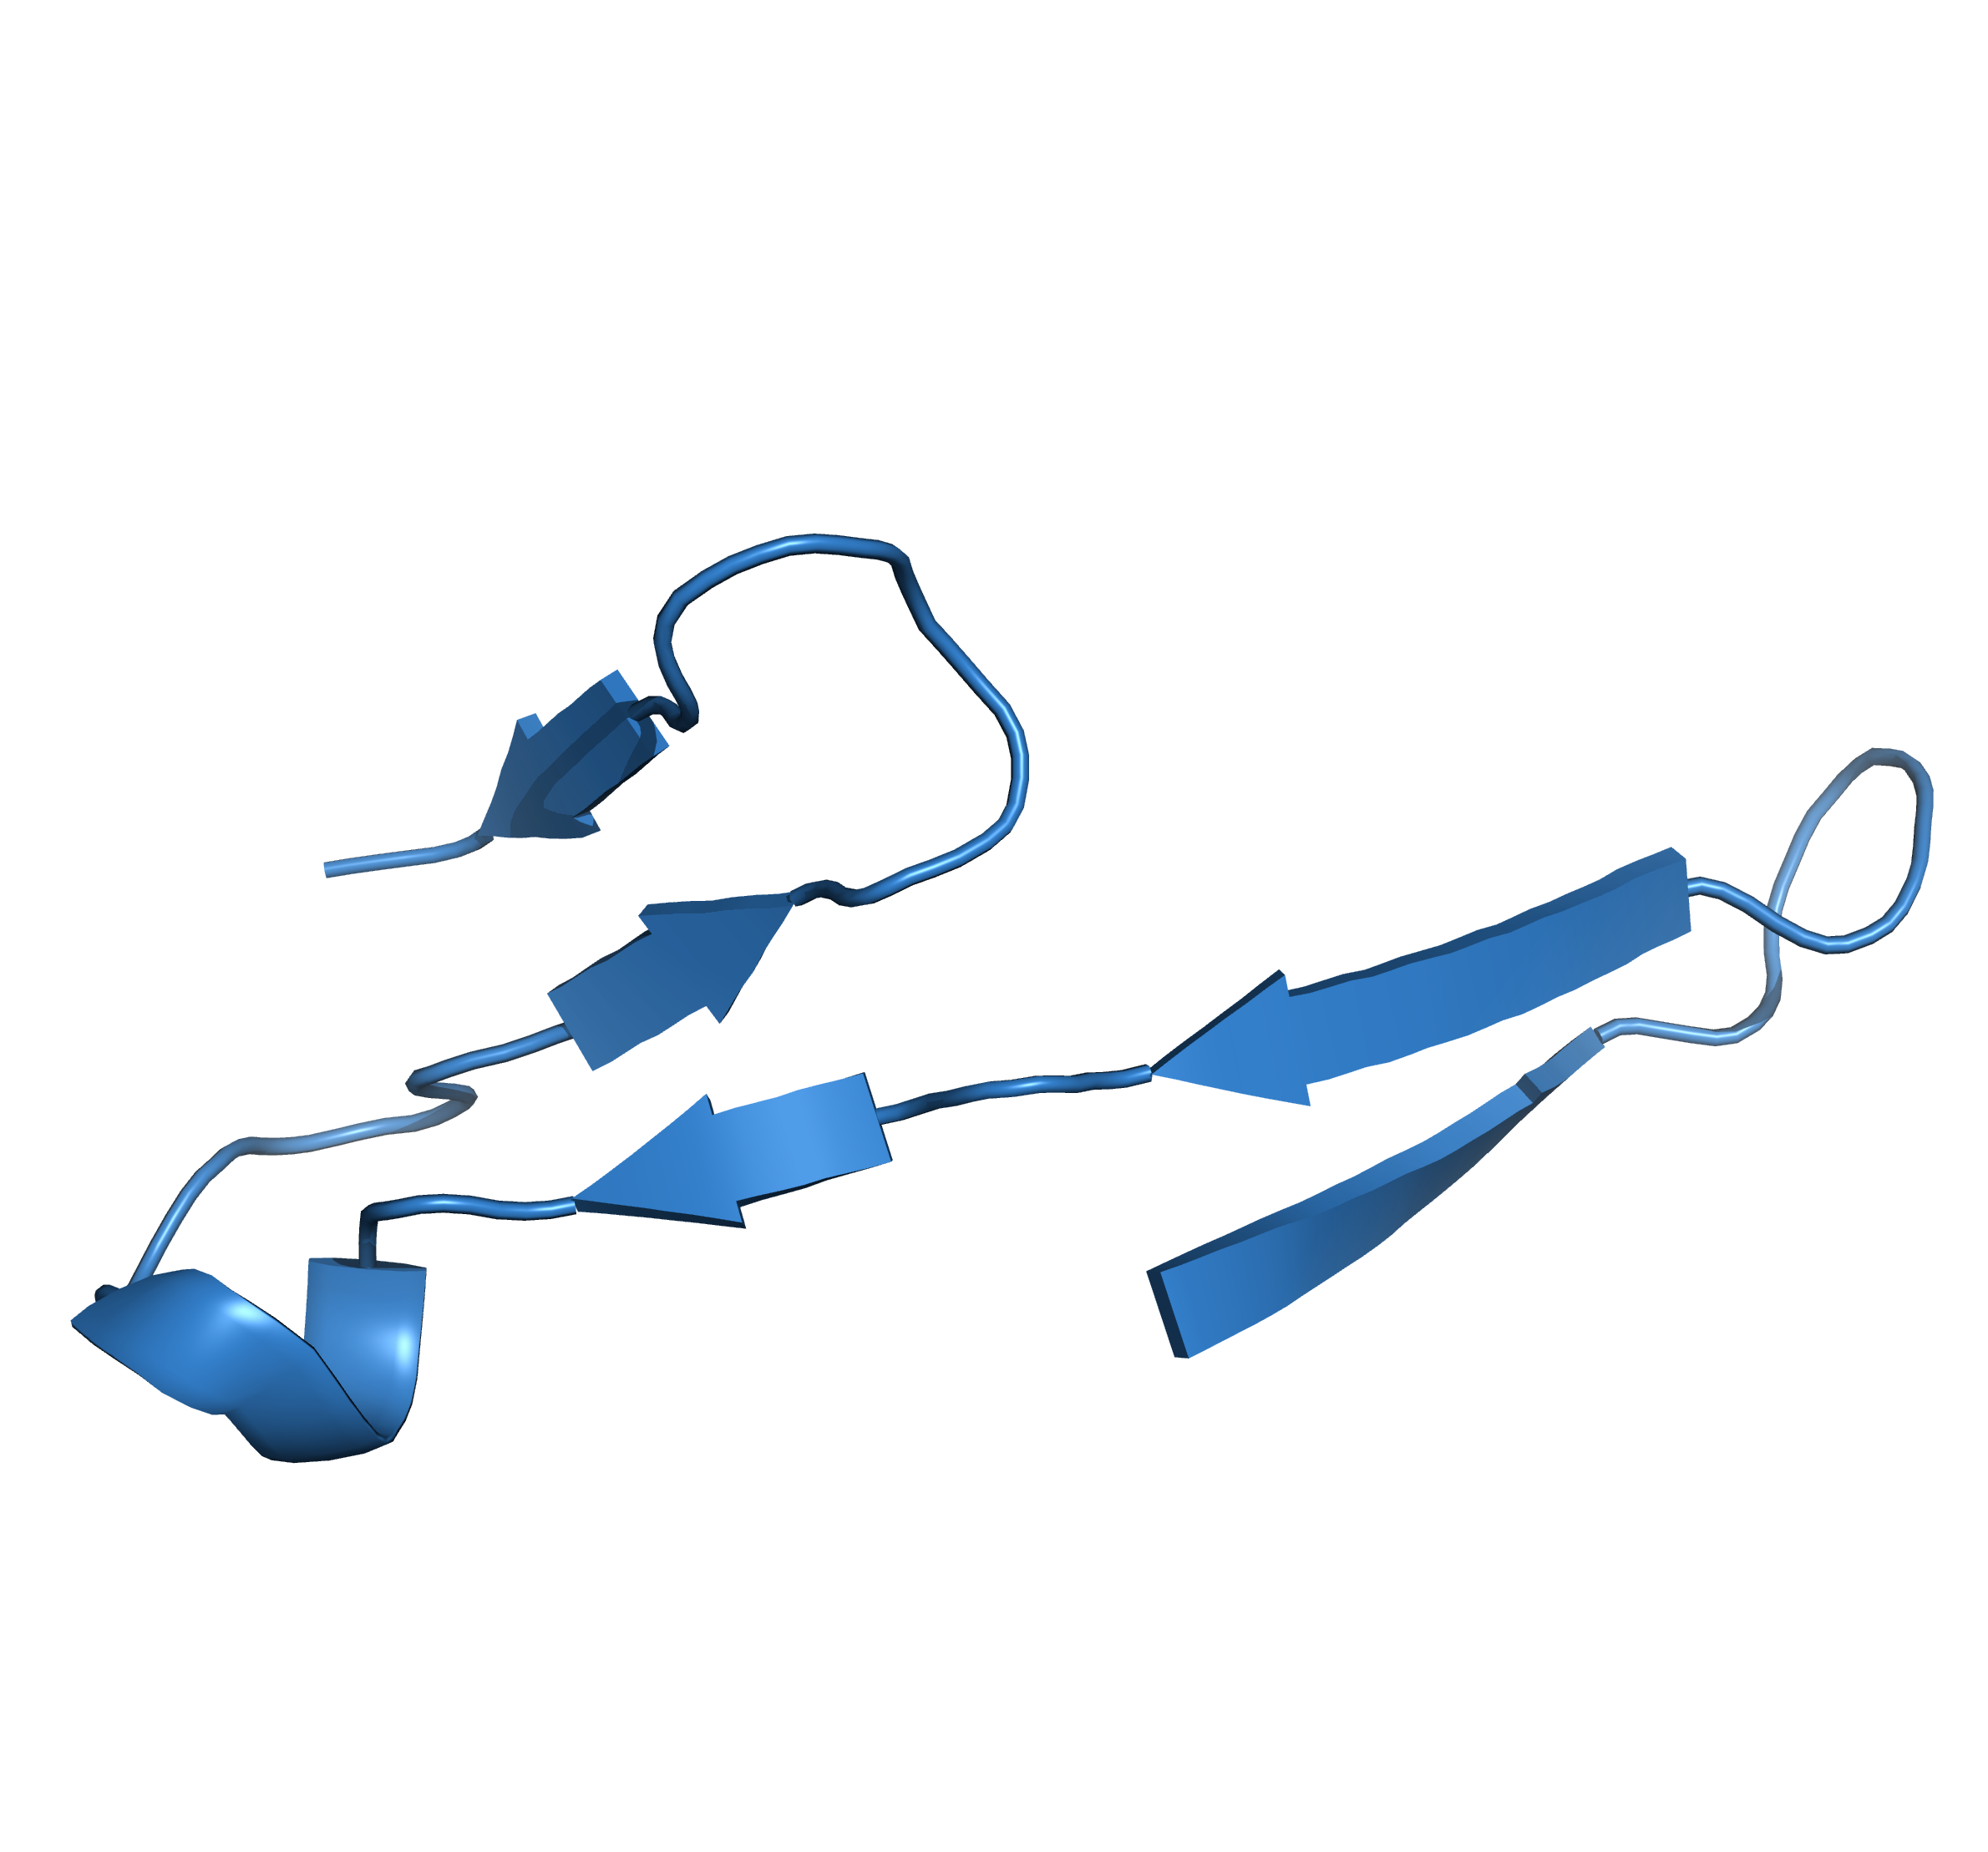
PCA & K-means on All Atom Coordinates
20.67%
27.32%
29.00%
23.01%

Slide 11
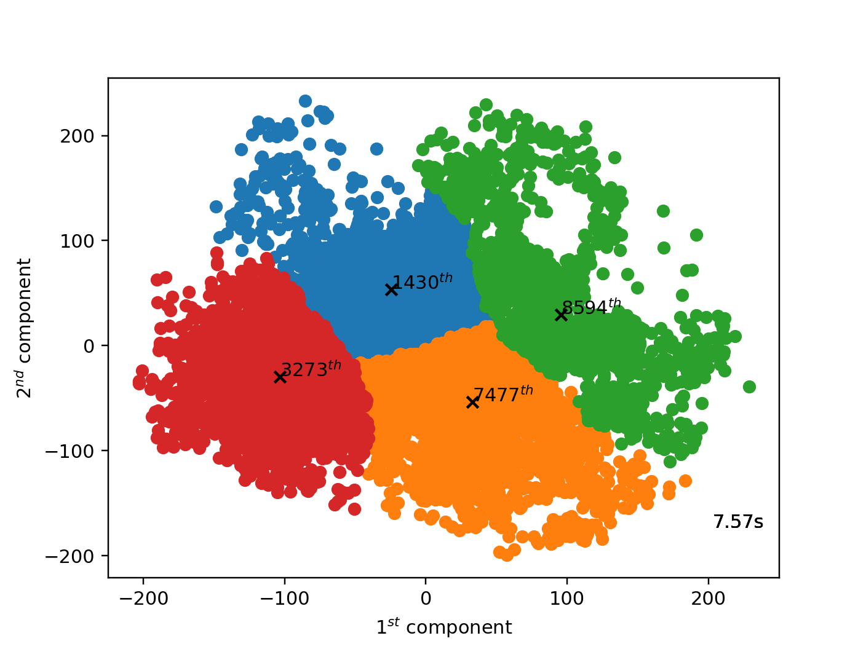
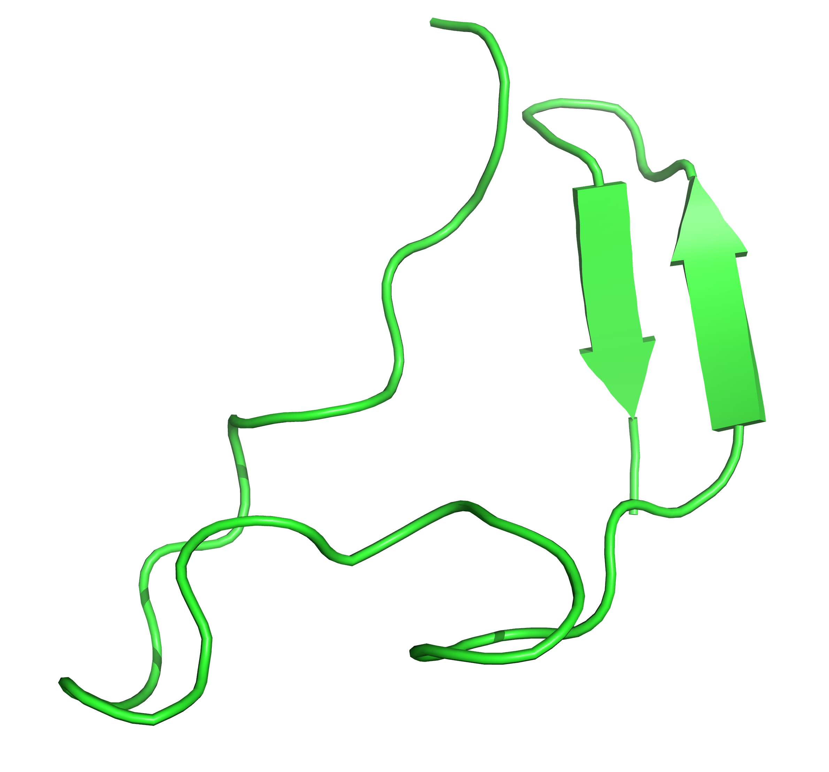
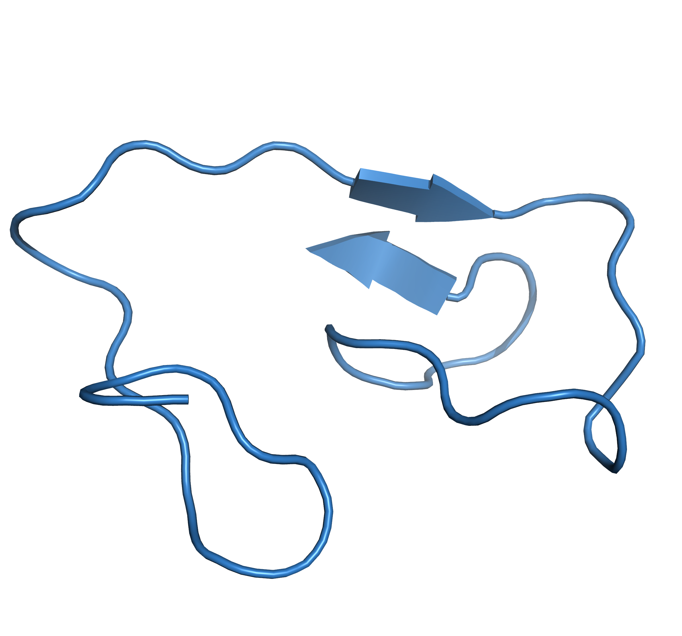
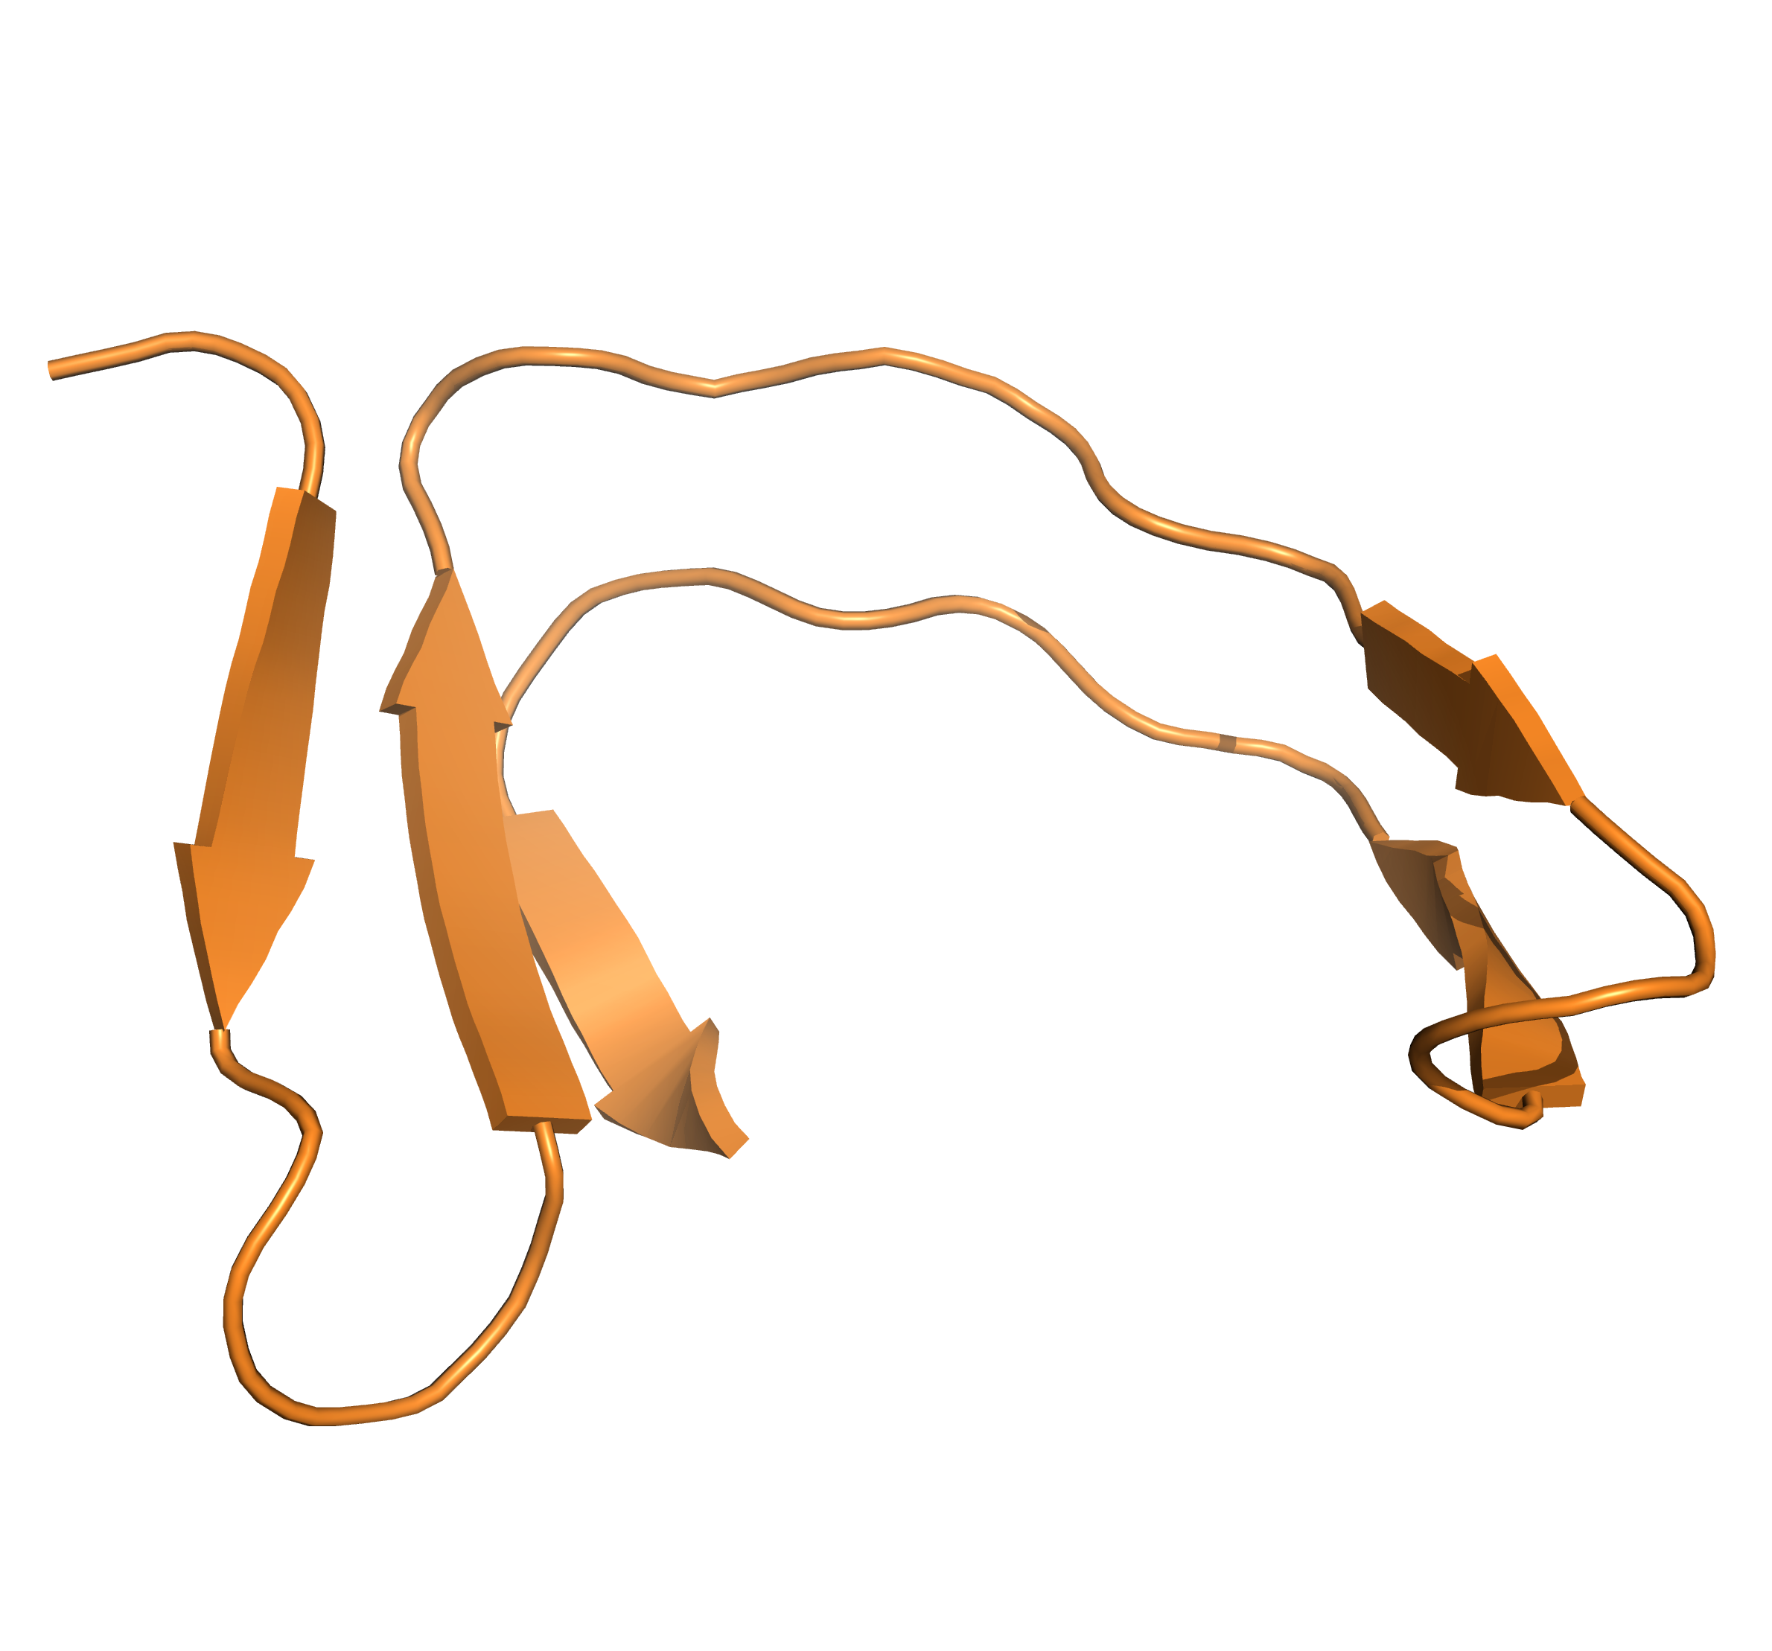
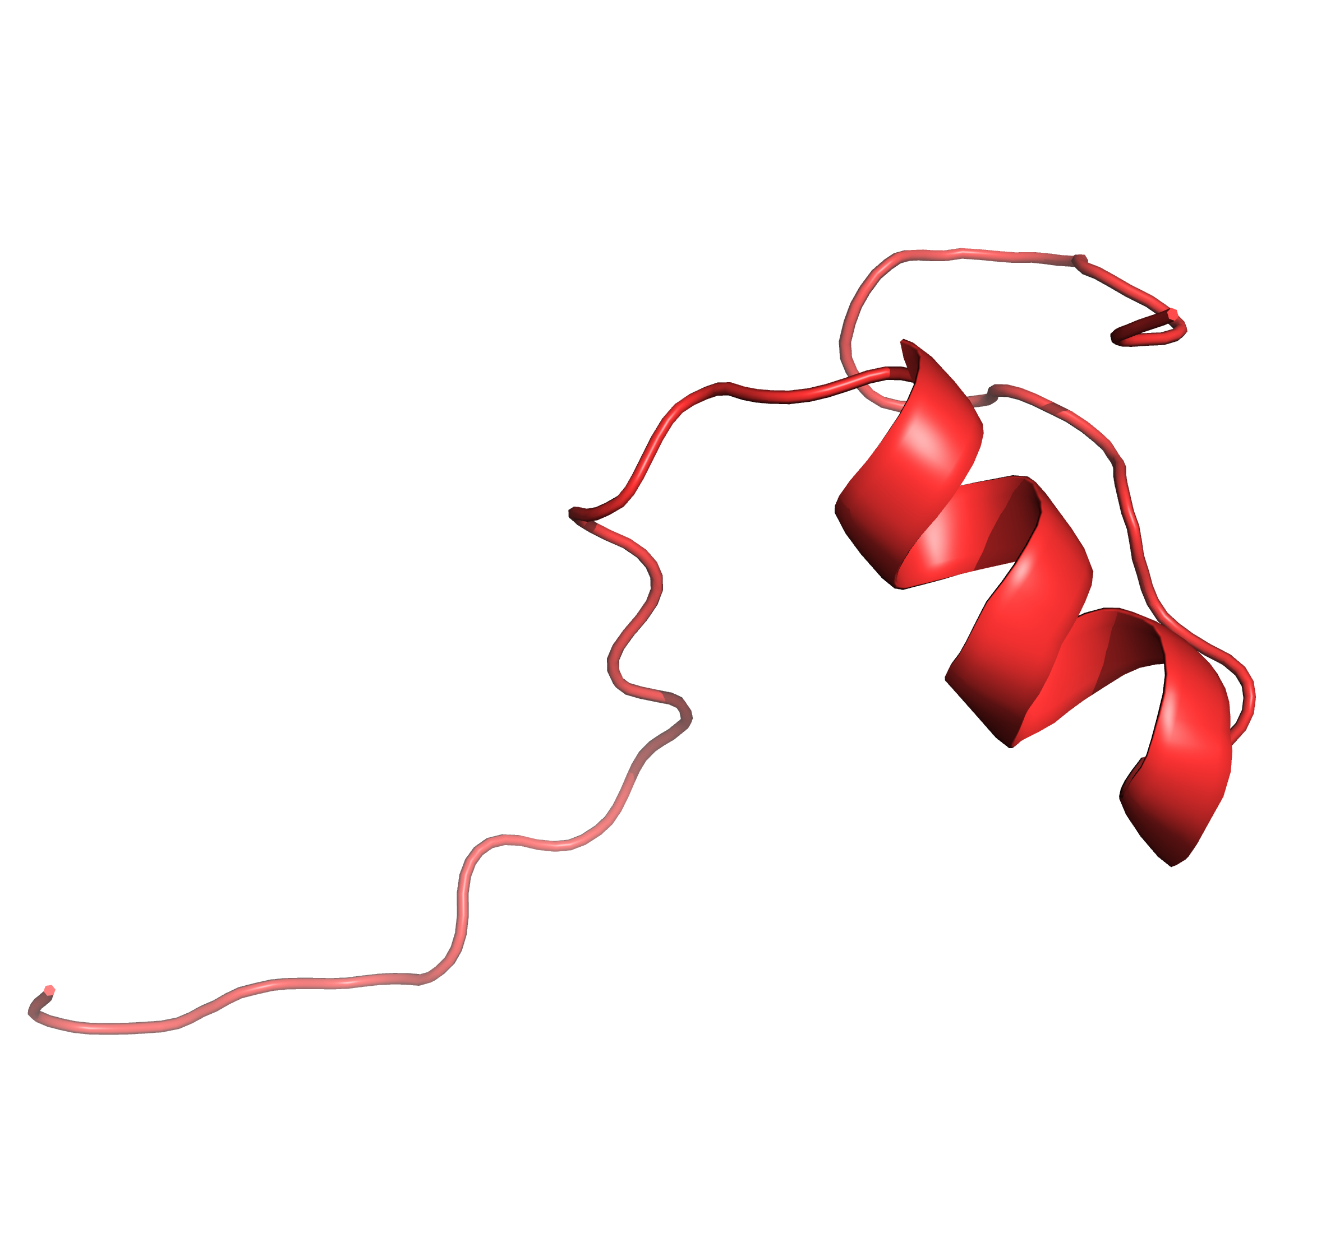
PCA & SC on All Atom Coordinates
27.10%
22.16%
22.17%
28.57%

Slide 12
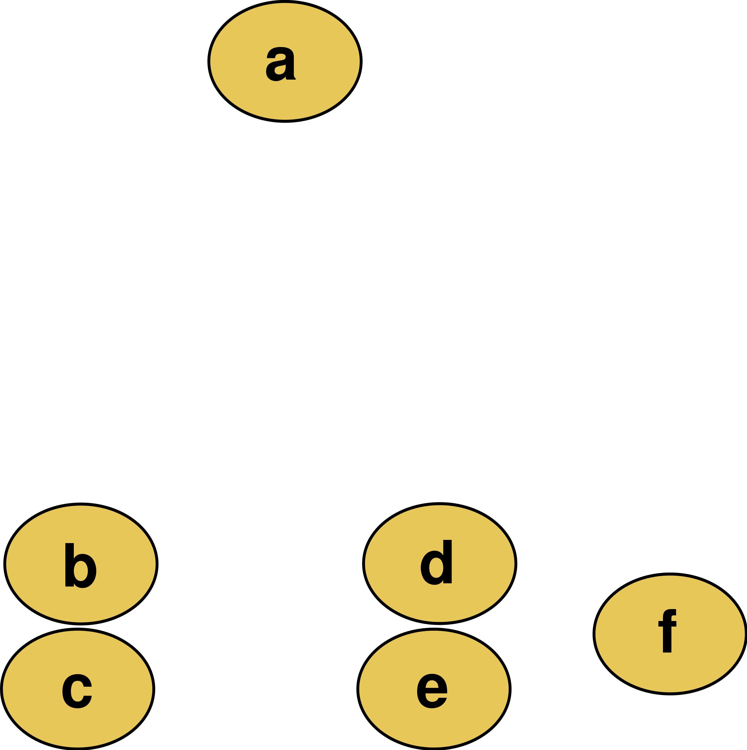
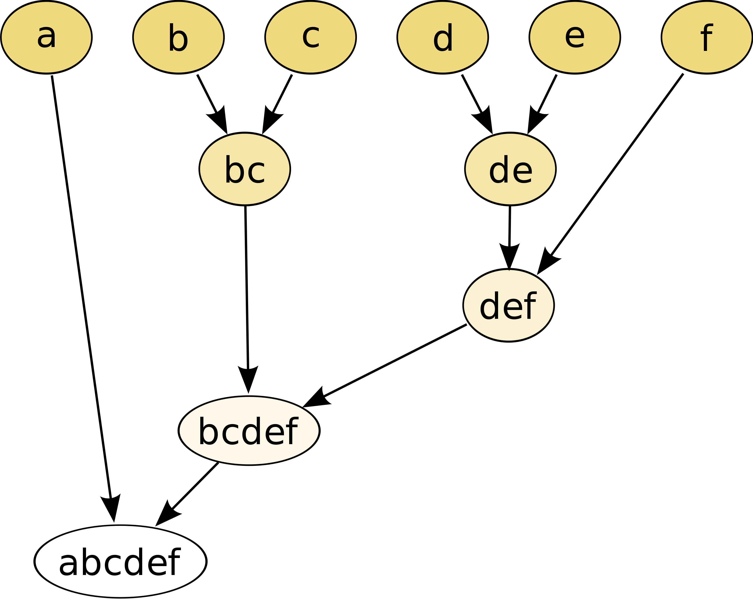
Clustering Method & Data
Hierarchical Clustering (HC)
Single-linkage criteria
Determines the distance between sets of observations as a function of the pairwise distances between observations
Pair-wise difference
Pair-wise RMSD
Dendrogram
https://en.wikipedia.org/wiki/Hierarchical_clustering

Slide 13
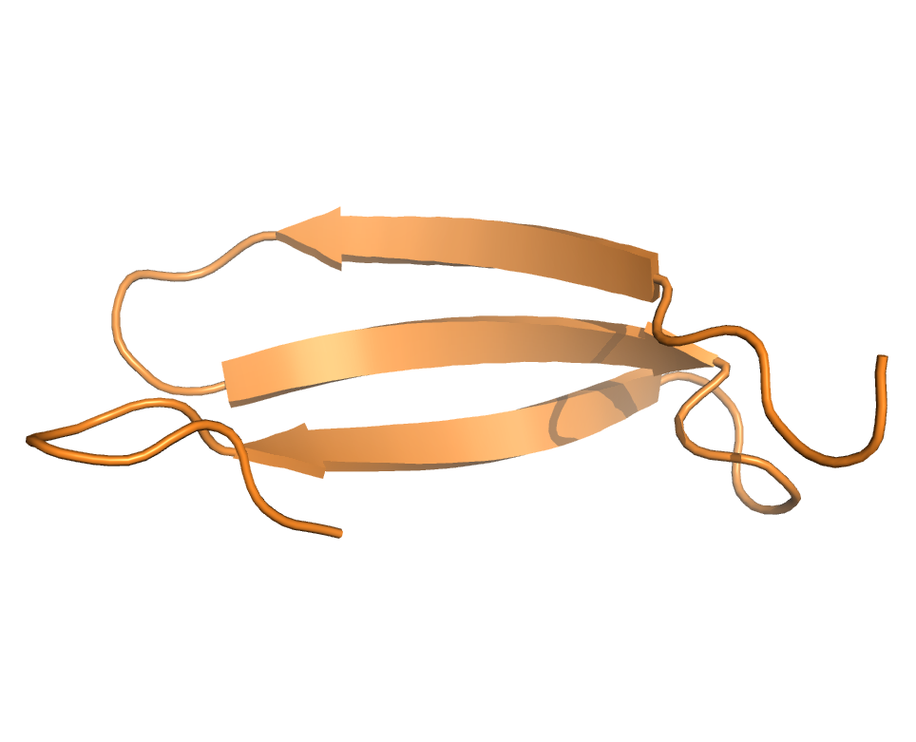
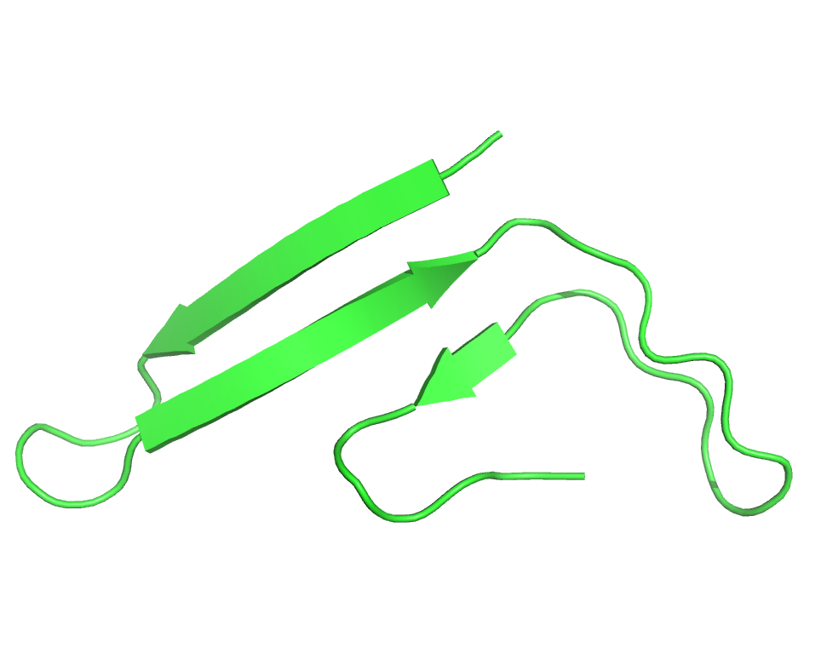
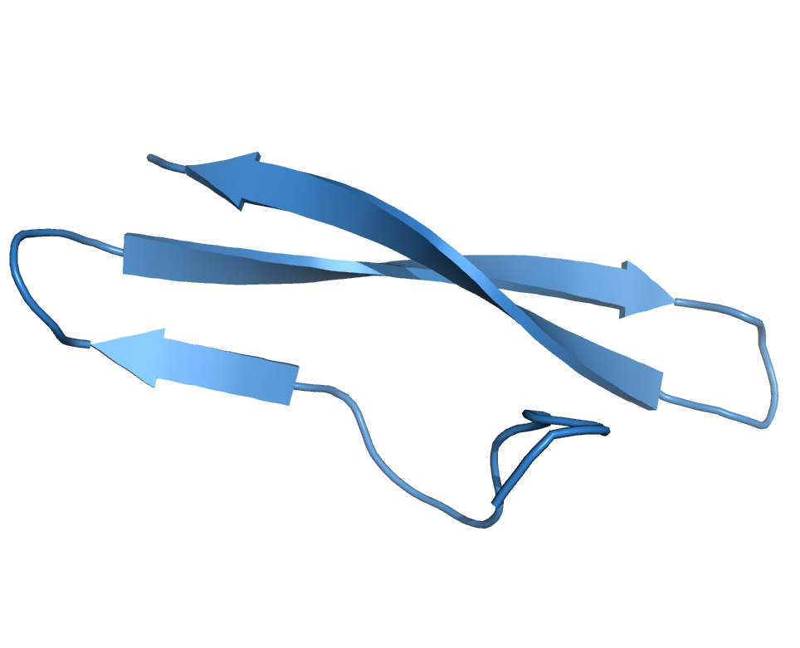
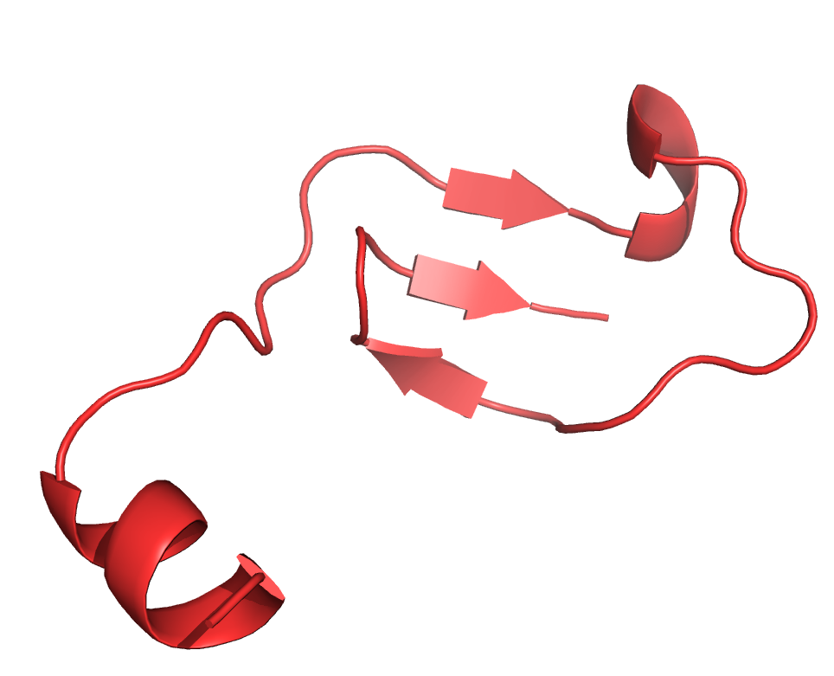
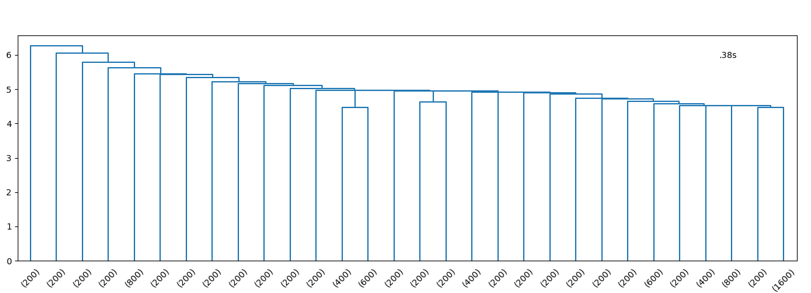
Hierarchical Clustering (HC)
2
3
4
1
1
4
2
3
Entity Score
Similar to PCA&SC on 5 features
Notes:
852.67s

Slide 14
Summary
K-means and SC can be used in protein structure analysis
PCA is able to help reduce feature dimensions before clustering
Hard to know physics interpretations of principle components
Method Selection
K-means is faster than SC and HC
K-means and SC require pre-knowledge on cluster numbers; Hard to visualize for high dimensional data
HC is not straightforward to examine results and require cutoffs; Easy to visualize high-dimensional data using dendrogram

Slide 15
Thank you

